Slide 1
Guided Propagation Along the Optical Fiber
Xavier Fernando
Ryerson University

Slide 2
The Nature of Light
Quantum Theory – Light consists of small particles (photons)
Wave Theory – Light travels as a transverse electromagnetic wave
Ray Theory – Light travels along a straight line and obeys laws of geometrical optics. Ray theory is valid when the objects are much larger than the wavelength (multimode fibers)

Slide 3
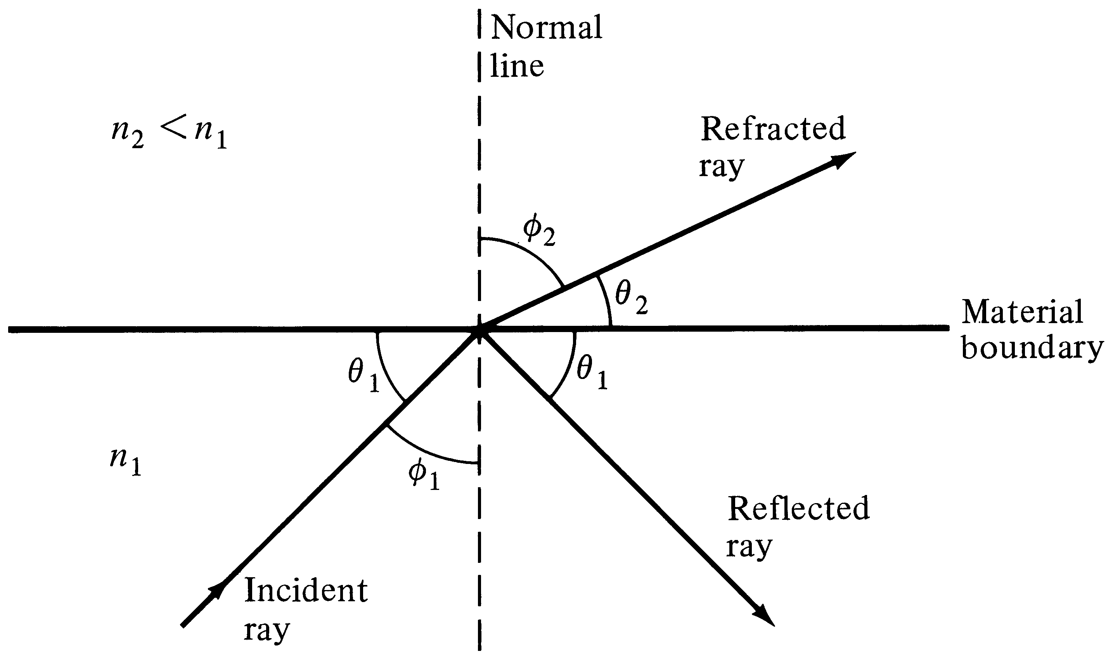
Refraction and reflection
Critical Angle:
Sin Φc=n₂/n₁
Snell’s Law: n₁ Sin Φ₁ = n₂ Sin Φ₂
Notes:
6

Slide 4
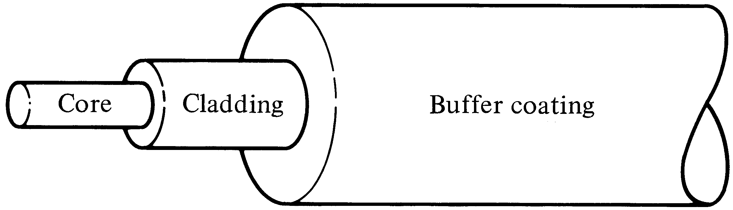
Step Index Fiber
n₁
n₂
n₁>n₂
Core and Cladding are glass with appropriate optical properties while buffer is plastic for mechanical protection

Slide 5
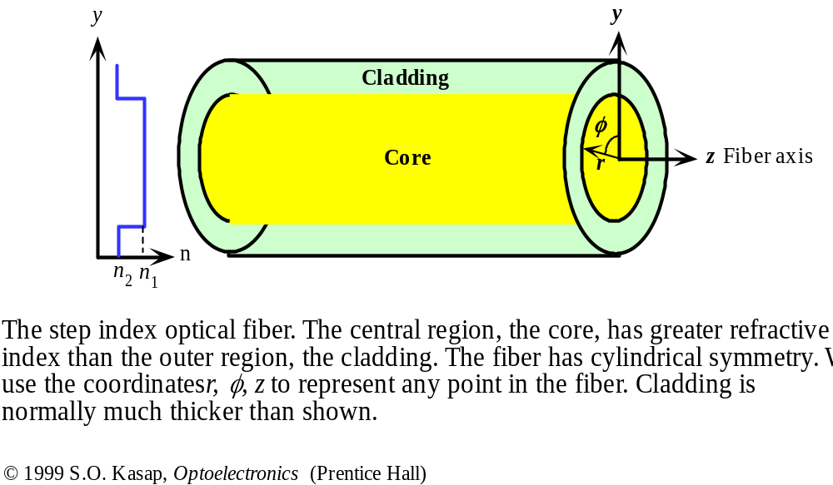
Step Index Fiber

Slide 6
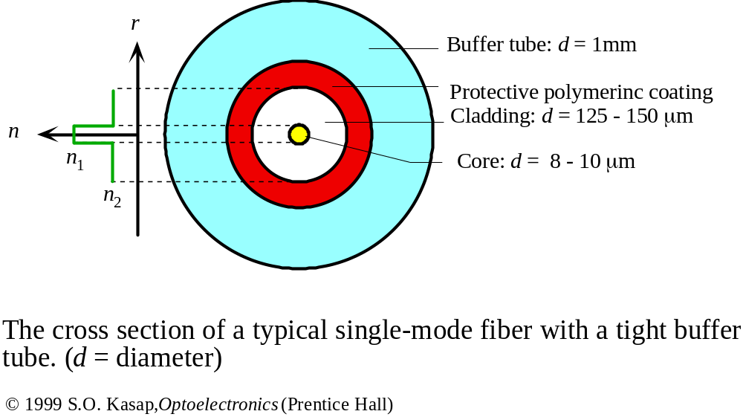
Single Mode Step Index Fiber

Slide 7
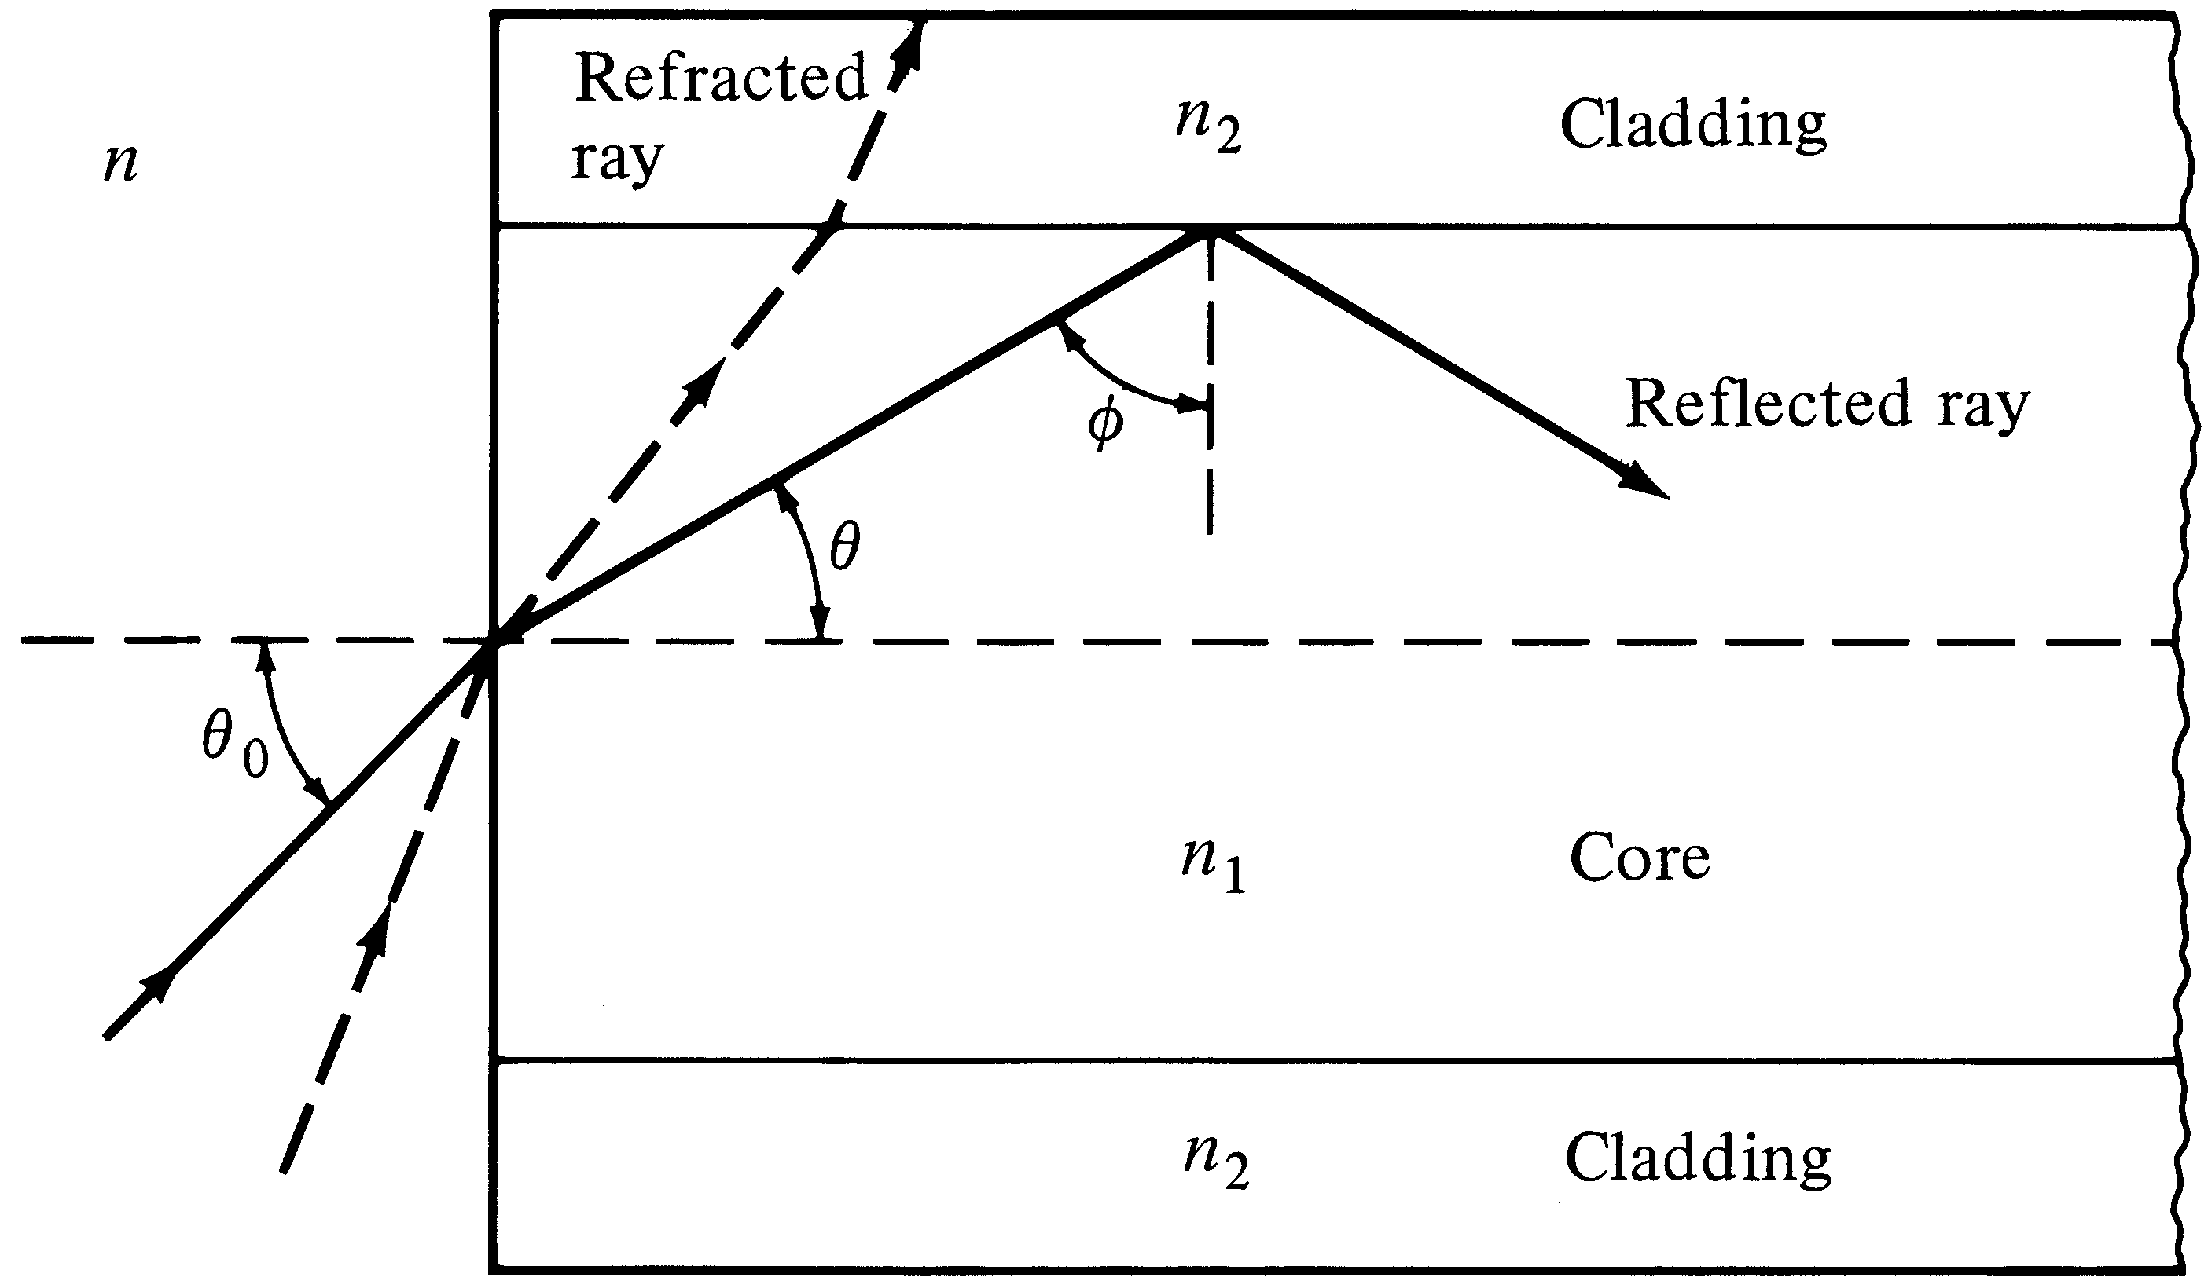
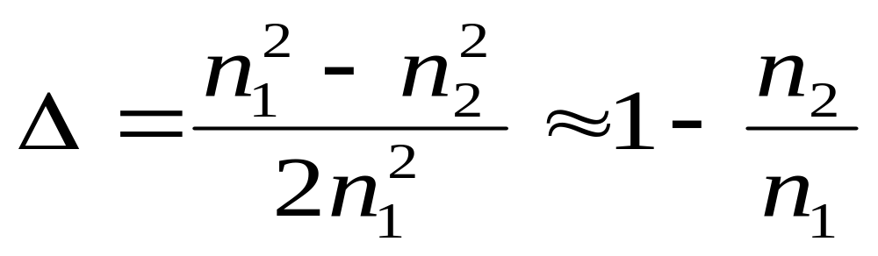
Meridian Ray Representation

Slide 8
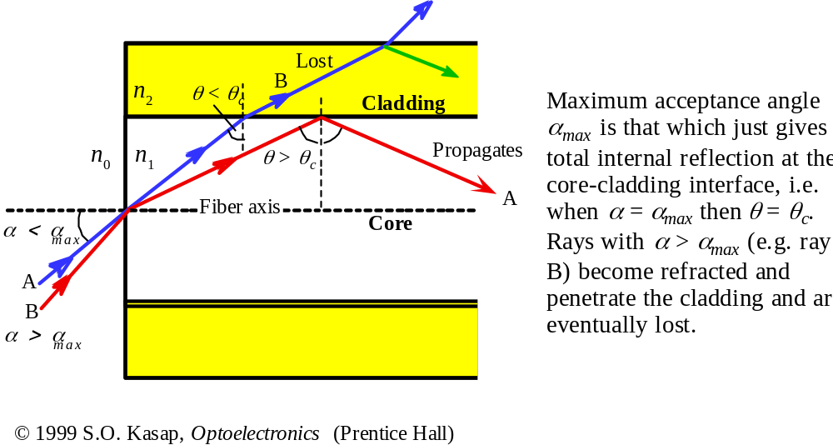
Total Internal Reflection

Slide 9
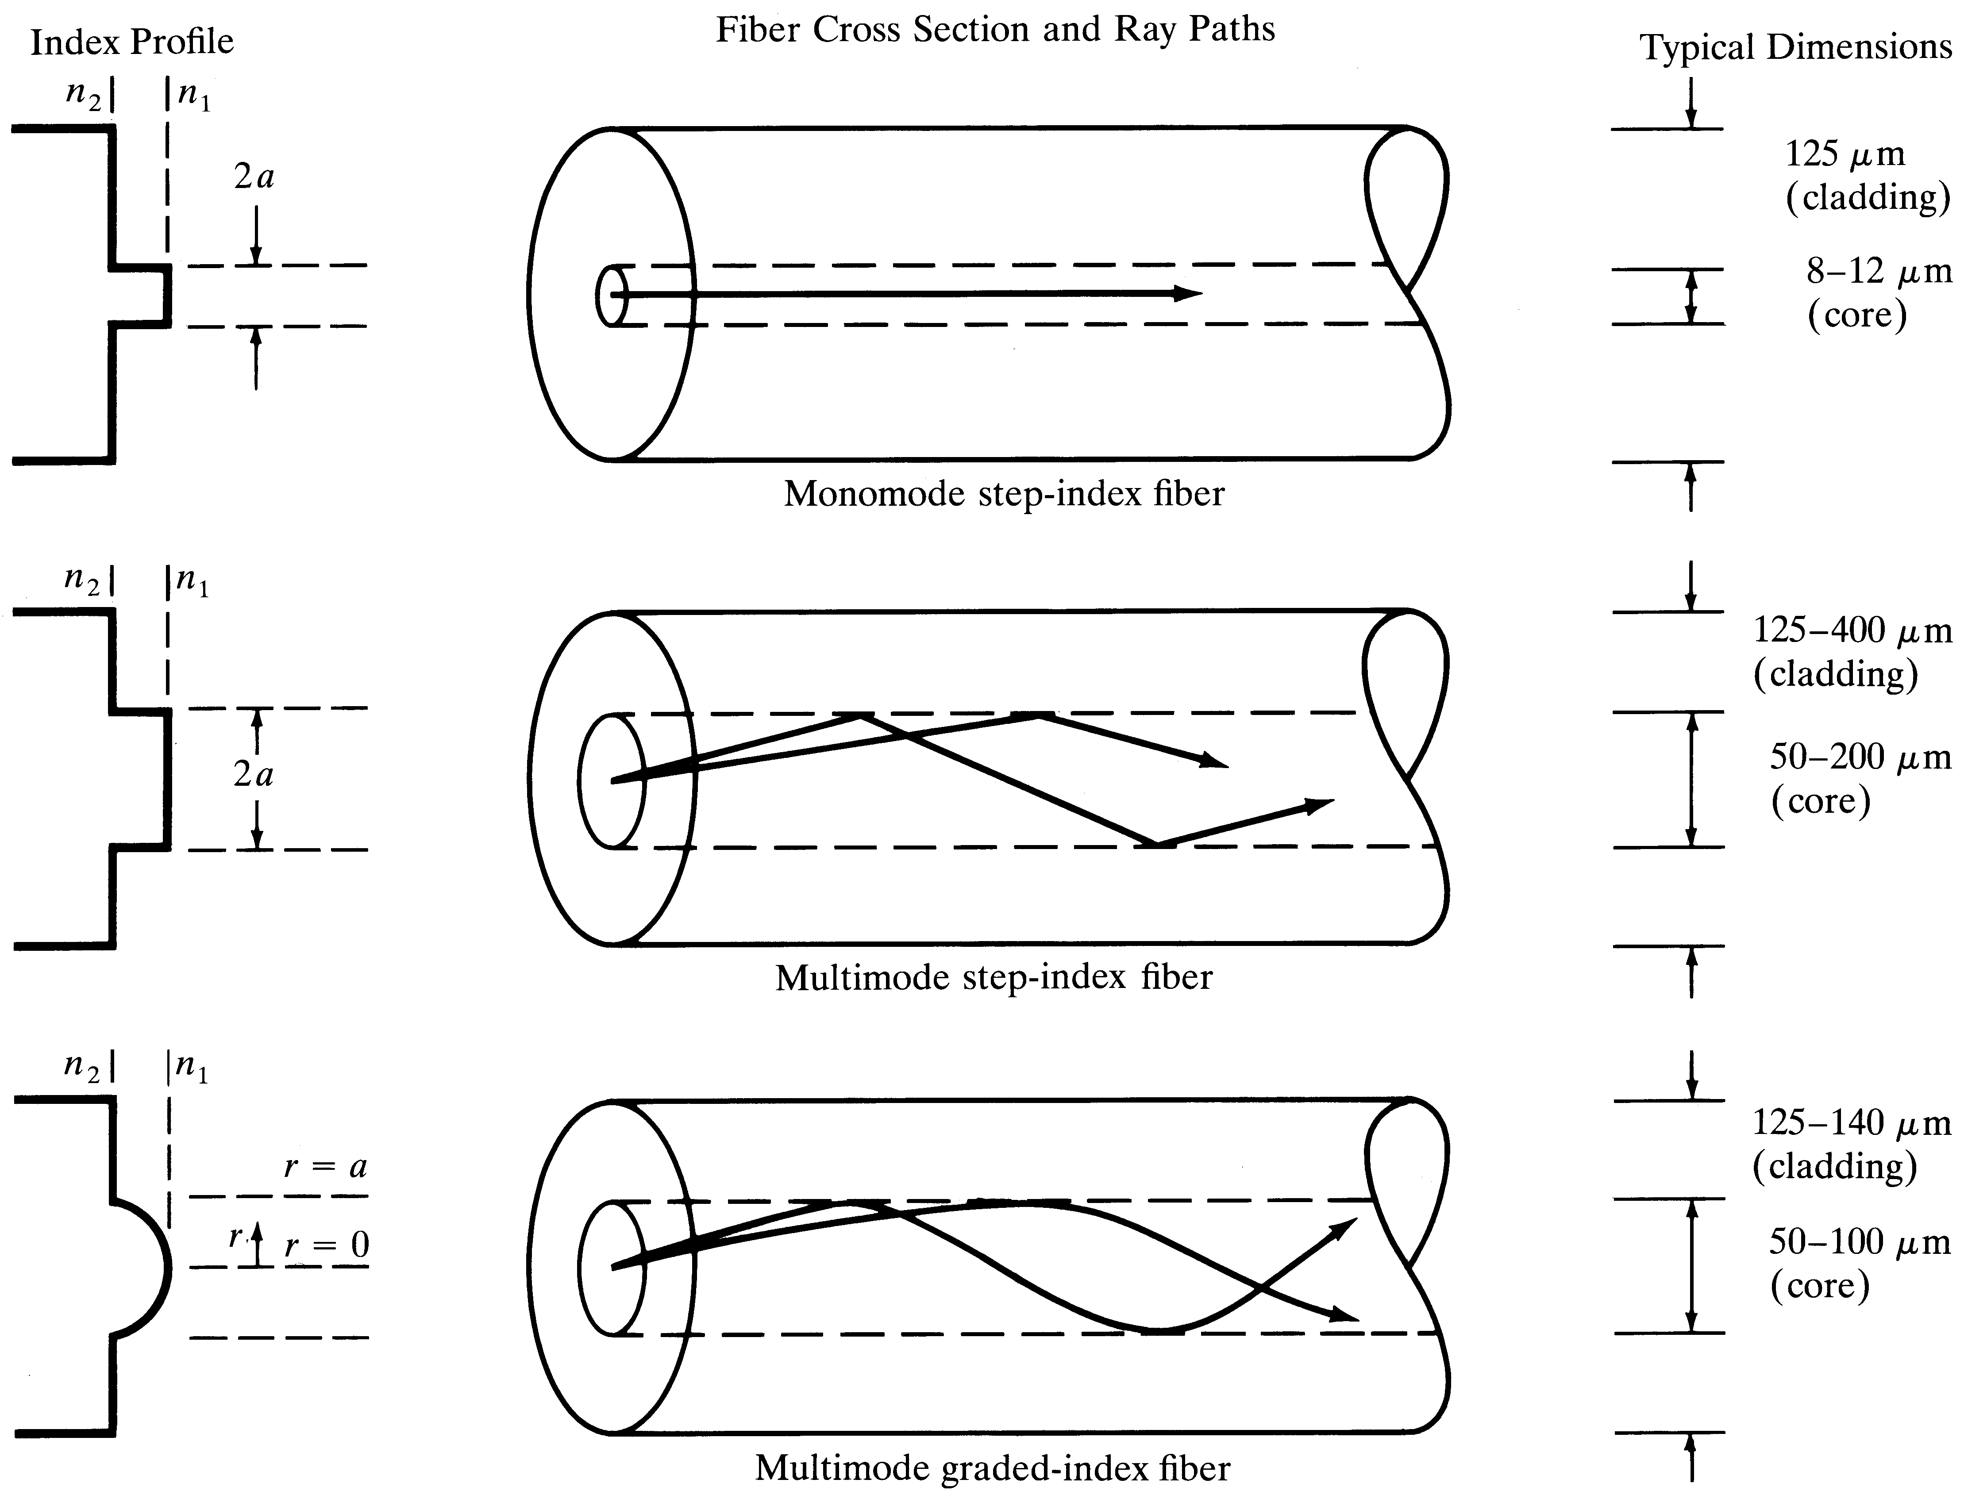
Comparison of fiber structures

Slide 10
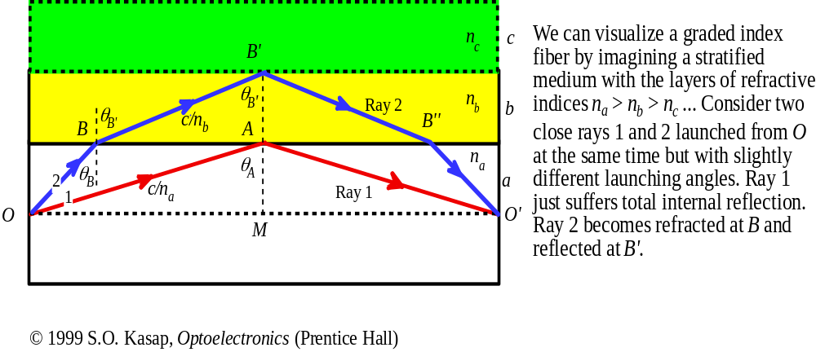
Graded Index Fiber

Slide 11
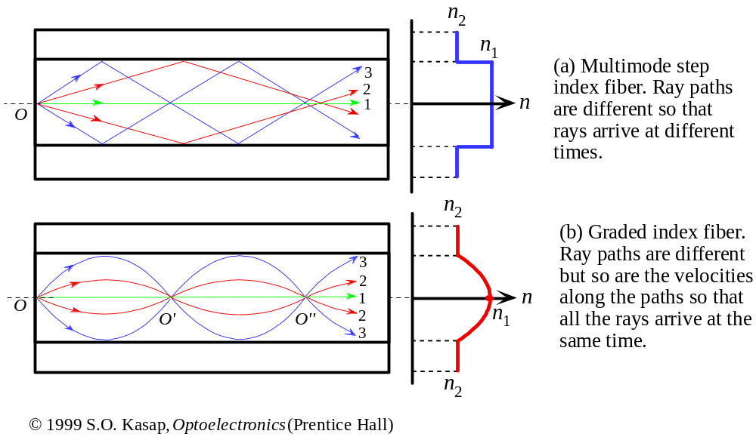
Step and Graded Index Fibers

Slide 12
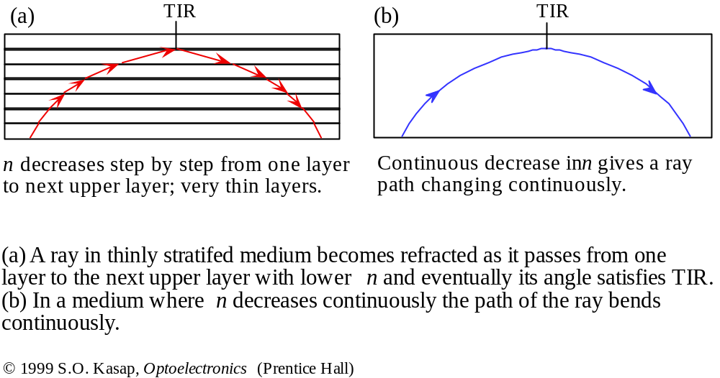
Total Internal Reflection

Slide 13
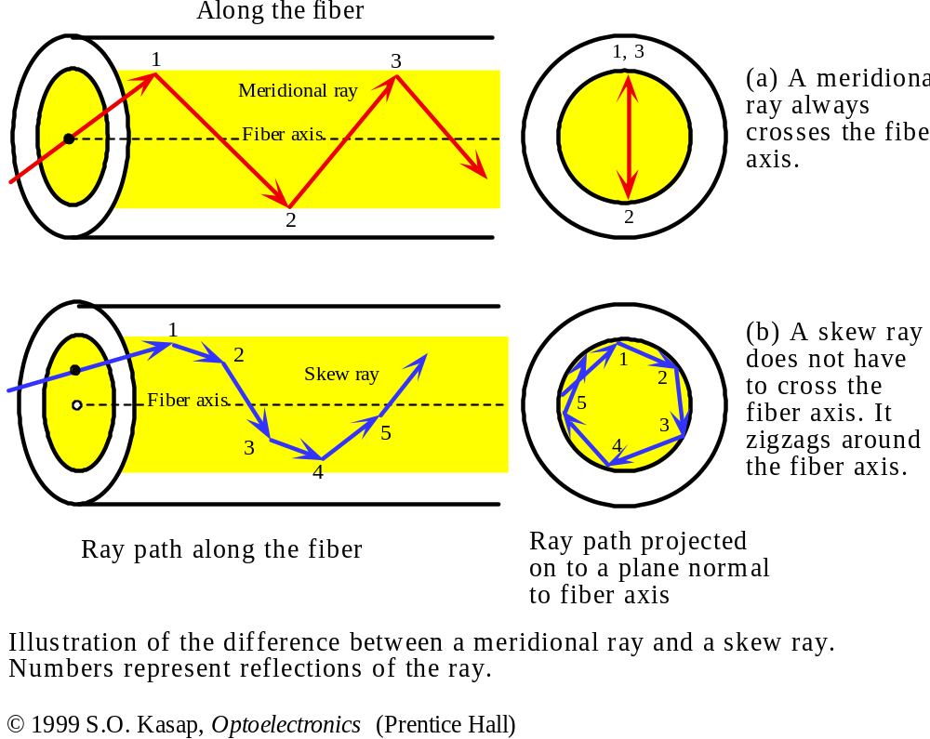
Skew Rays

Slide 14
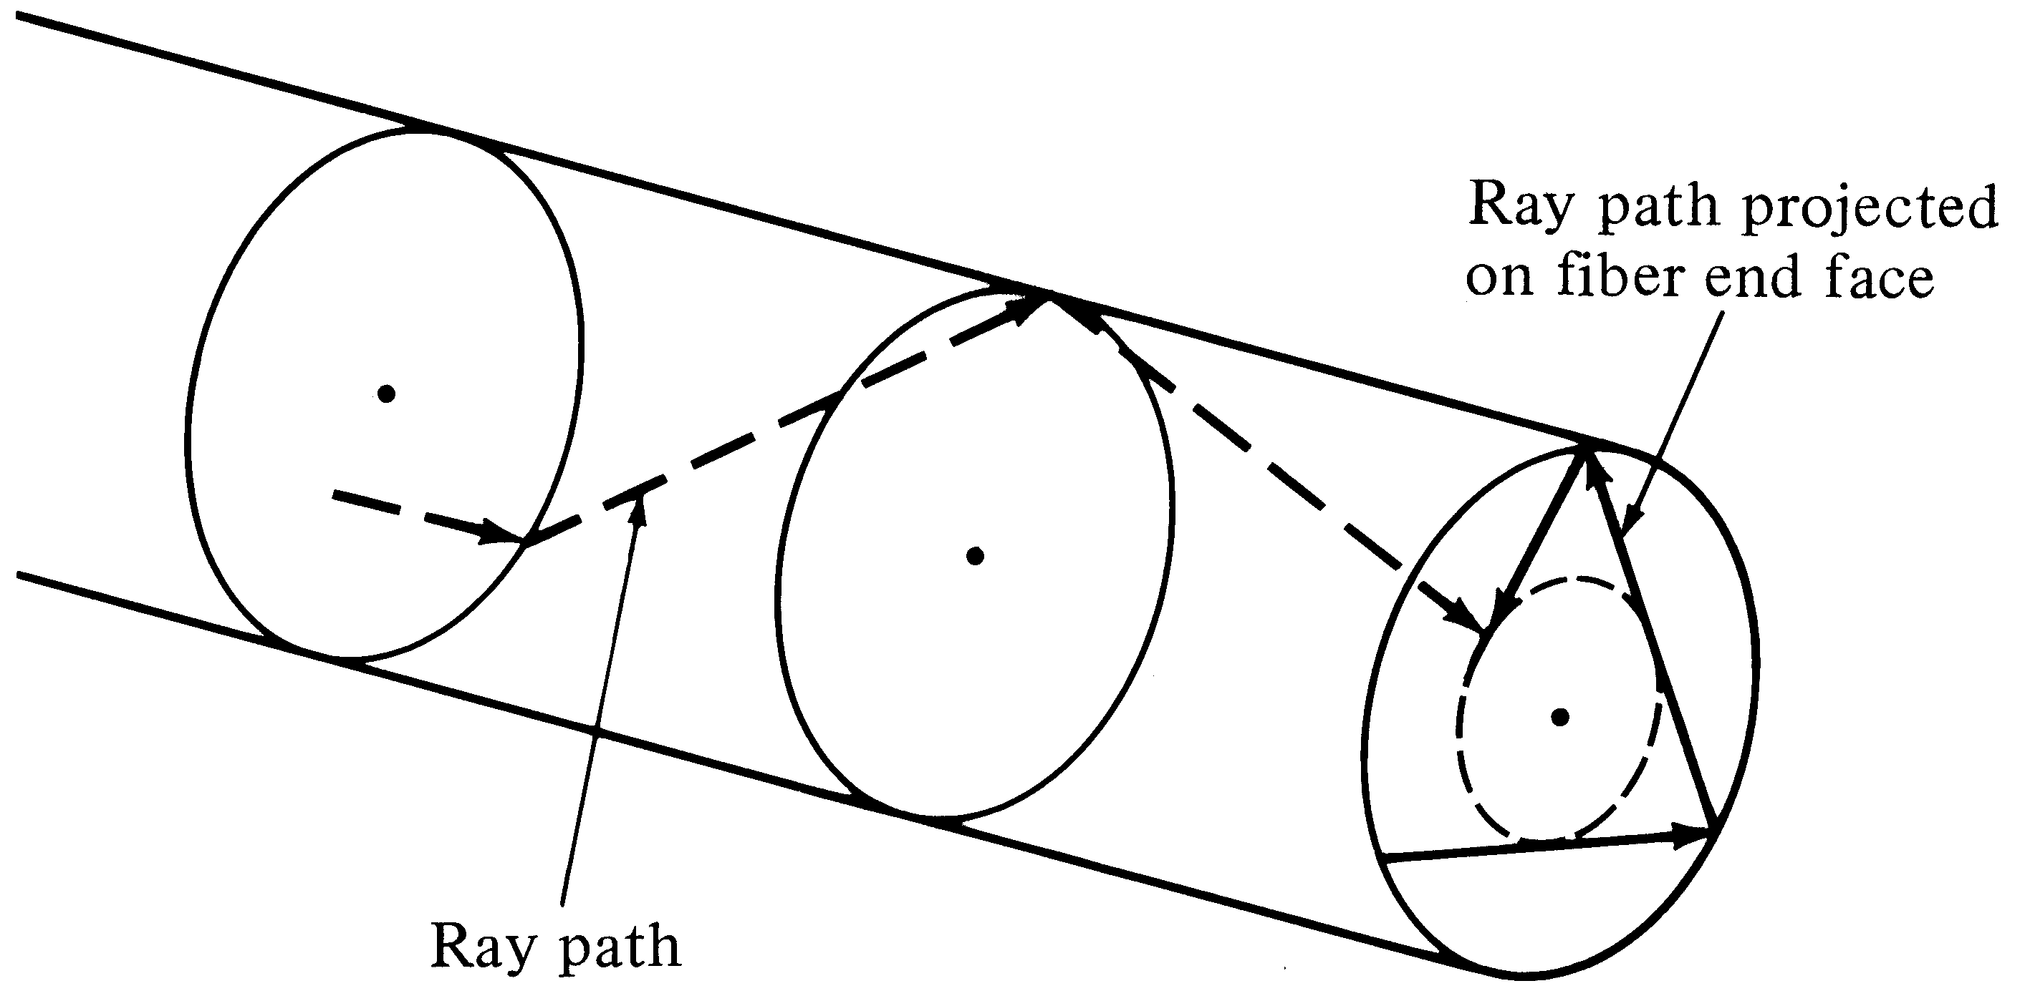
Skew rays
Skew rays circulate around the core and increase the dispersion

Slide 15
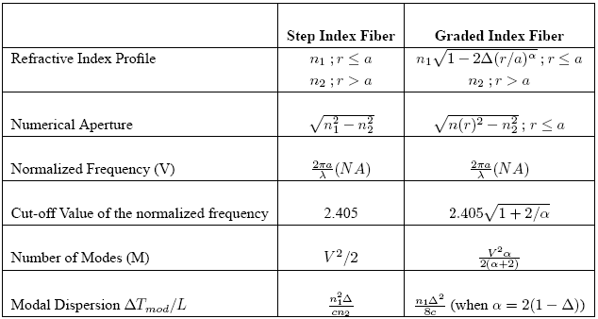
Fiber Key Parameters

Slide 16
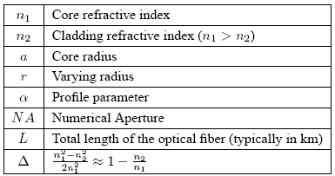
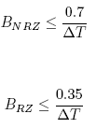
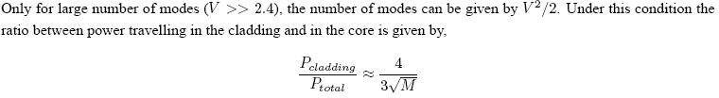
Fiber Key Parameters

Slide 17
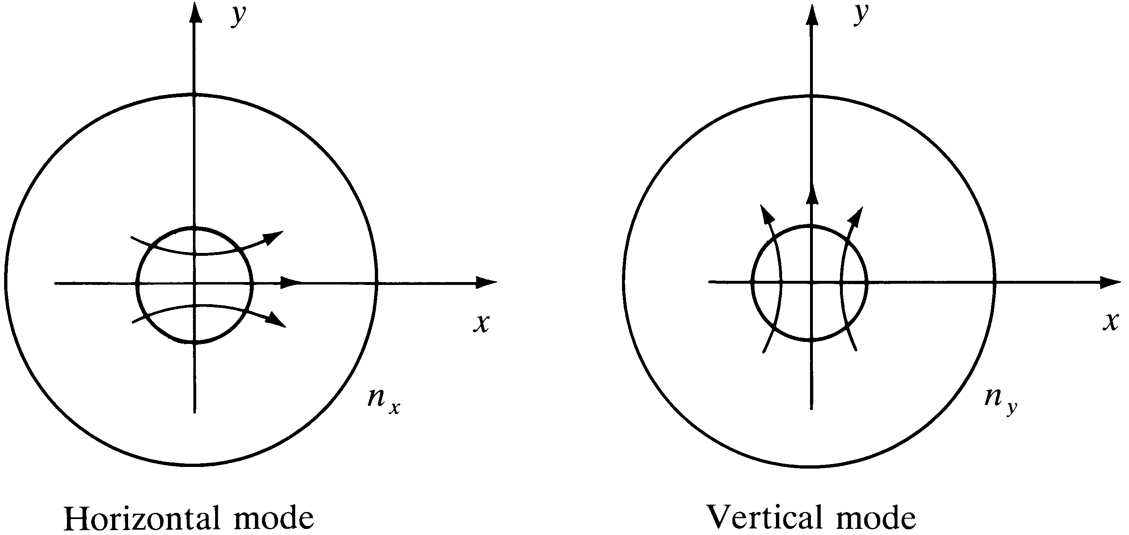
Polarizations of fundamental mode
Two polarization states exist in the fundamental mode in a single mode fiber

Slide 18
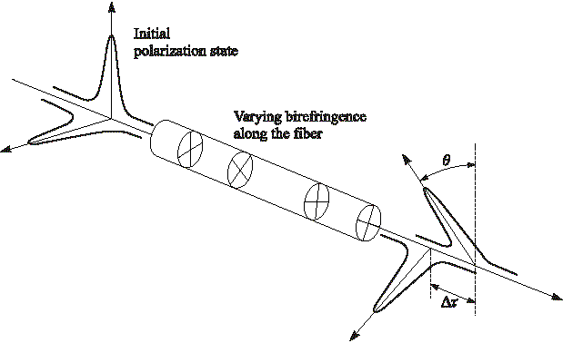
Polarization Mode Dispersion (PMD)
Each polarization state has a different velocity → PMD
Notes:
8

Slide 19
Major Dispersions in Fiber
Modal Dispersion: Different modes travel at different velocities, exist only in multimodal conditions
Waveguide Dispersion: Signal in the cladding travel with a different velocity than the signal in the core, significant in single mode conditions
Material Dispersion: Refractive index n is a function of wavelength, exists in all fibers, function of the source line width

Slide 20
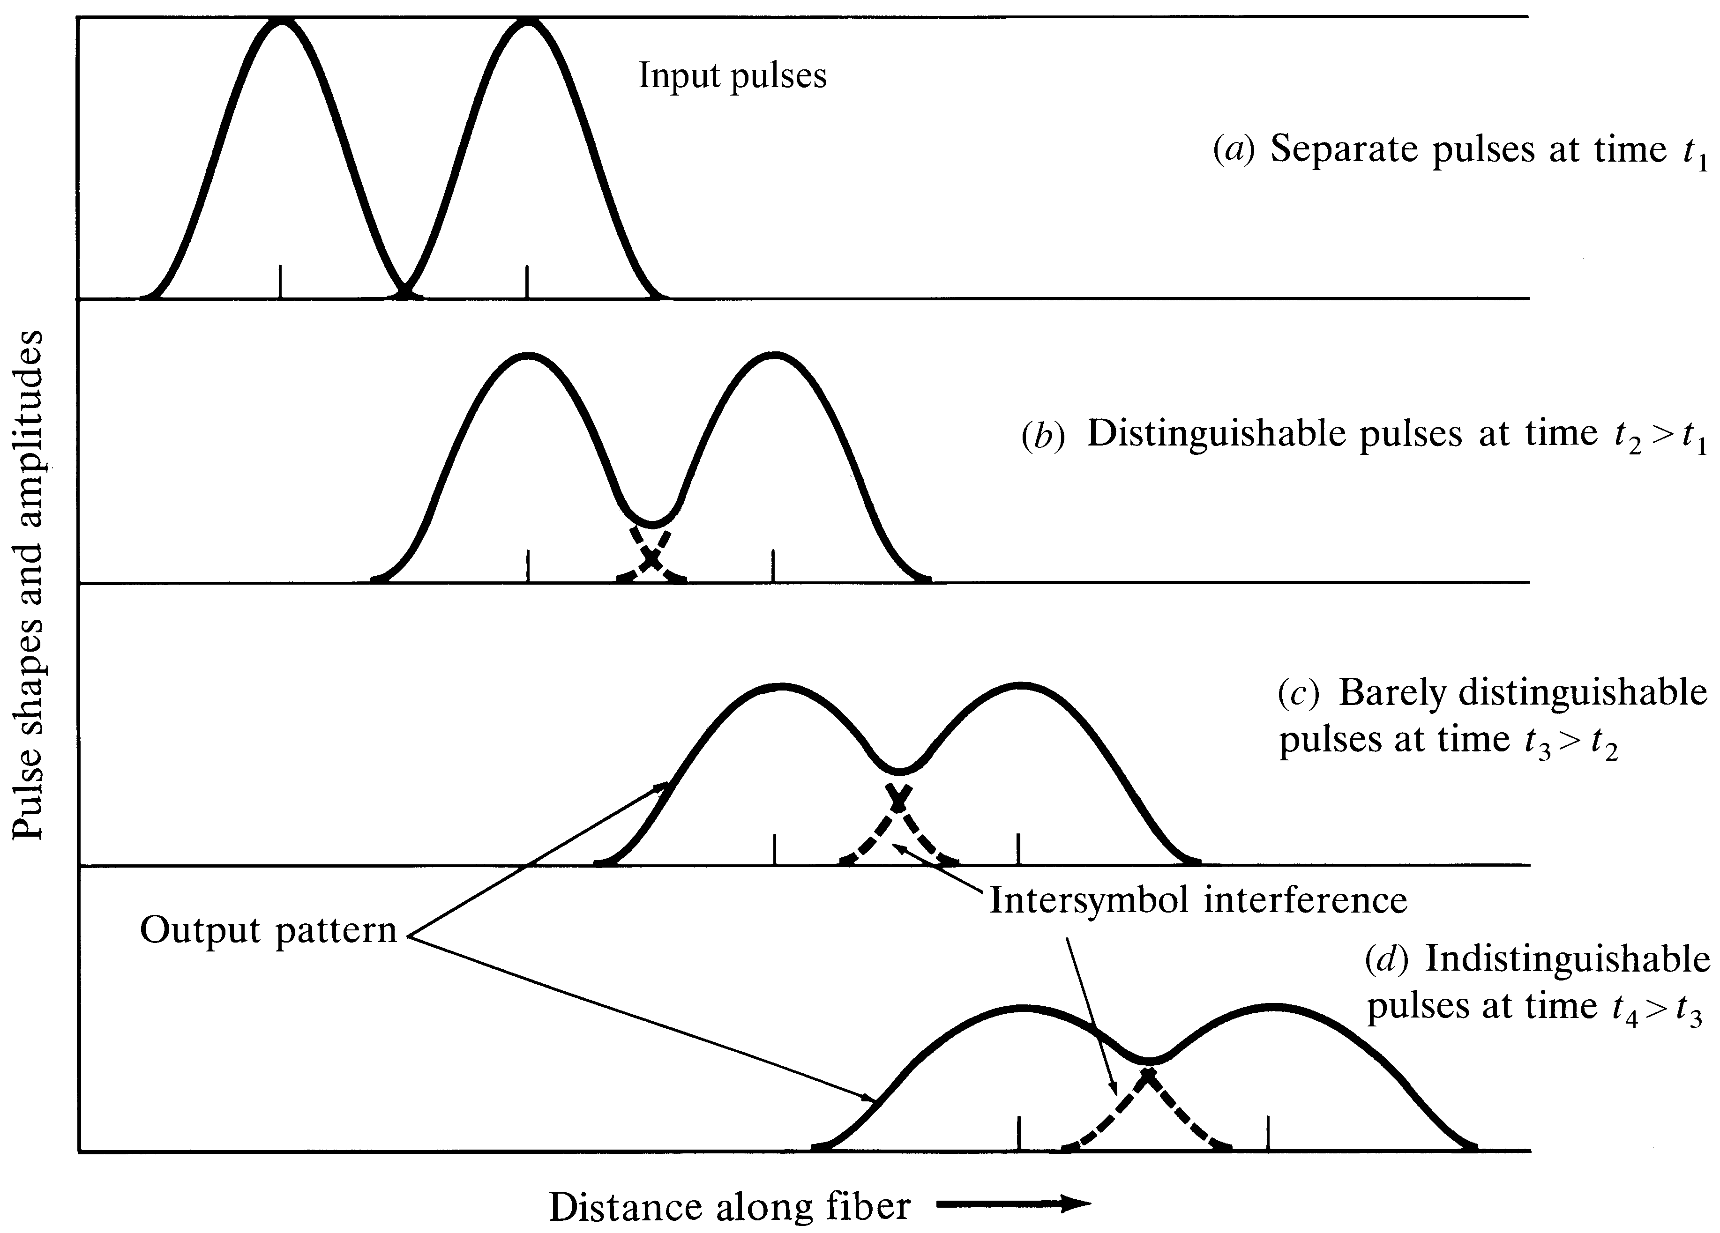
Effects of Dispersion and Attenuation
Notes:
7

Slide 21
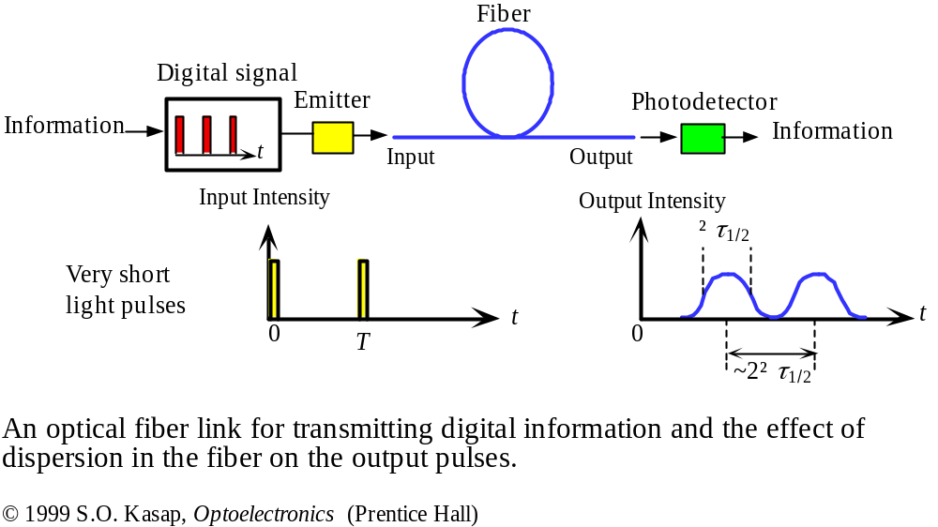
Dispersion for Digital Signals

Slide 22
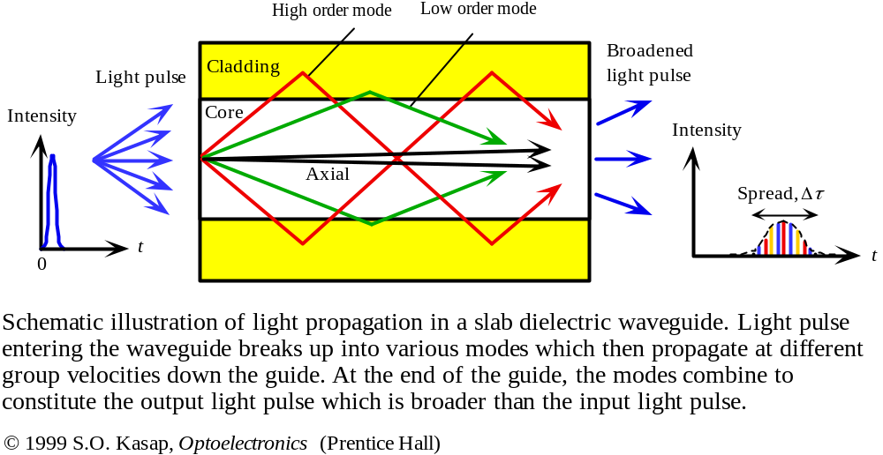
Modal Dispersion

Slide 23
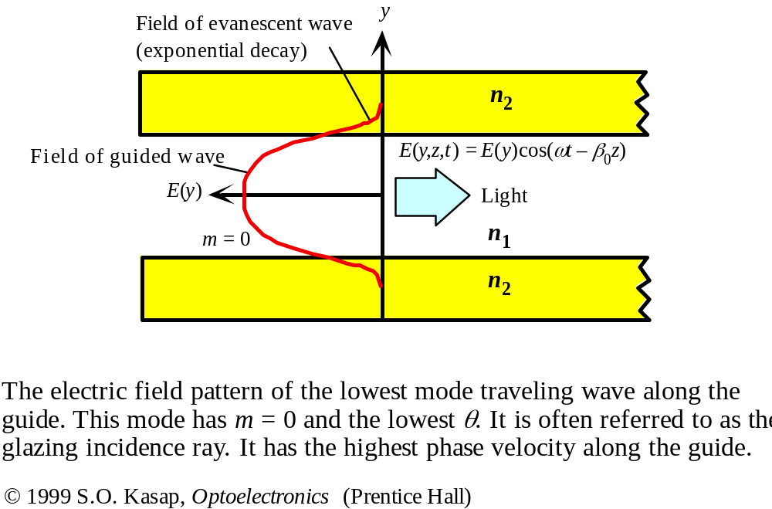
Field Distribution in the Fiber

Slide 24
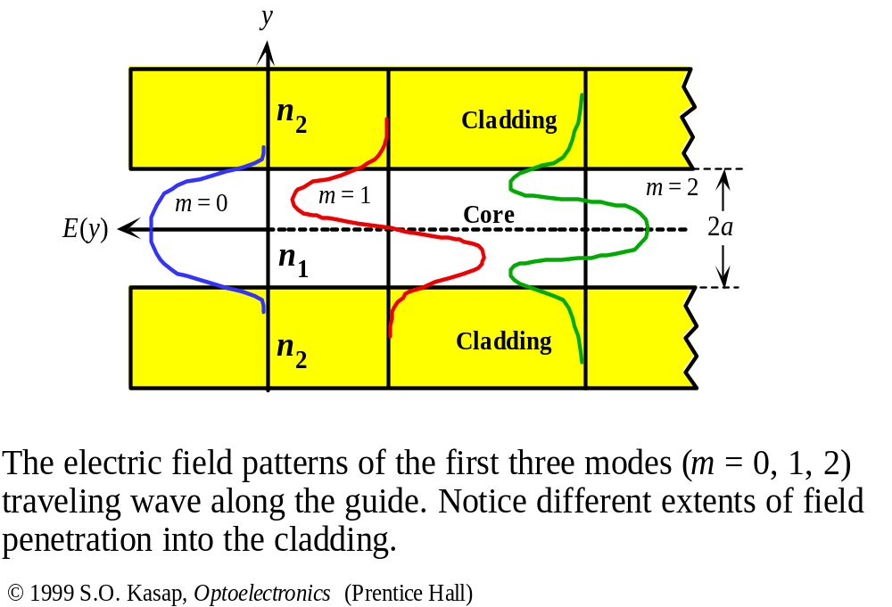
Higher order modes → Larger MFD

Slide 25
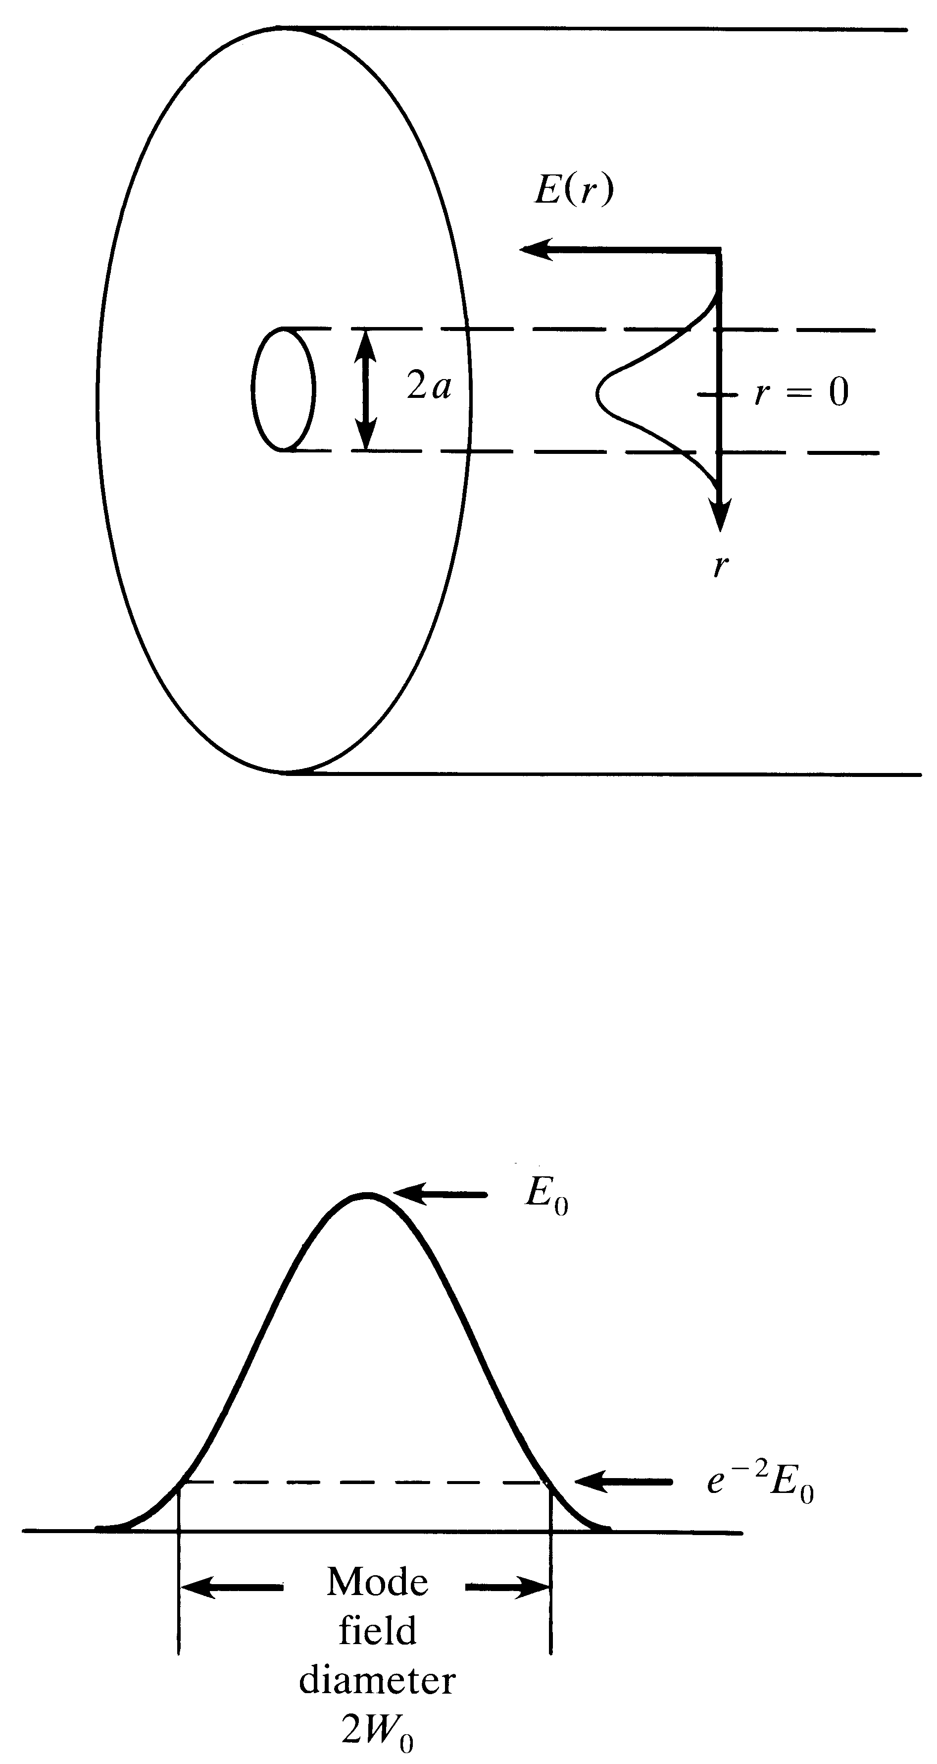
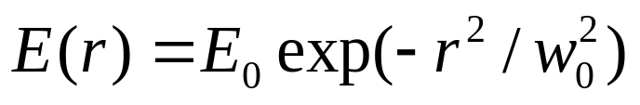
Mode-field
Diameter (2W₀)
In a Single Mode Fiber,
At r = w_{o,}
E(W_{o})=E_{o}/e
Typically W_{o} > a

Slide 26
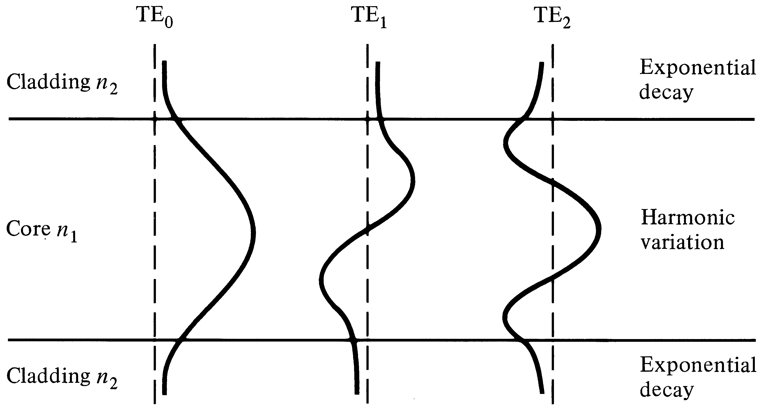
Power in the cladding
Lower order modes have higher power in the cladding.

Slide 27
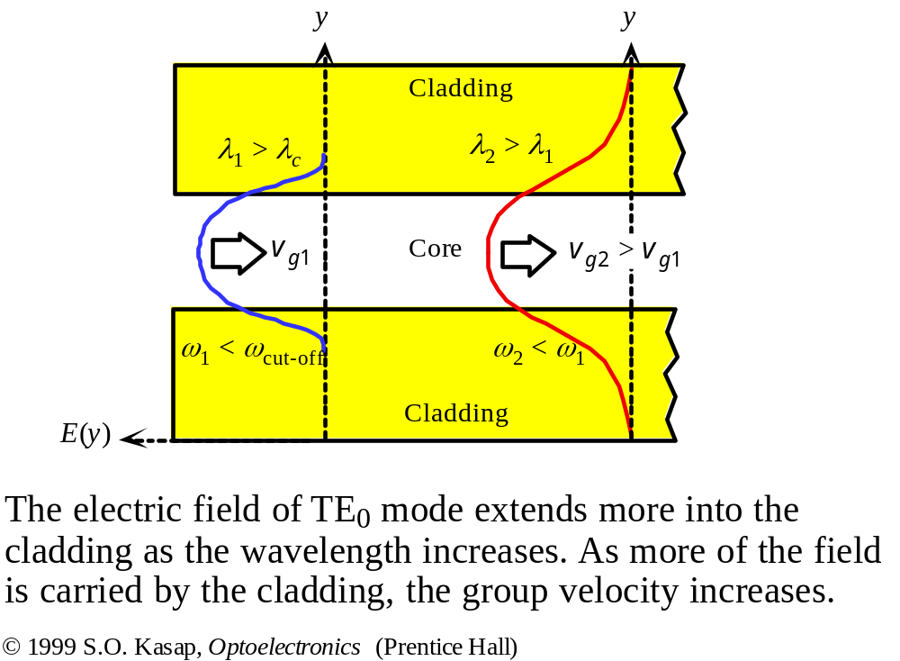
Higher the Wavelength →
More the Evanescent Field

Slide 28
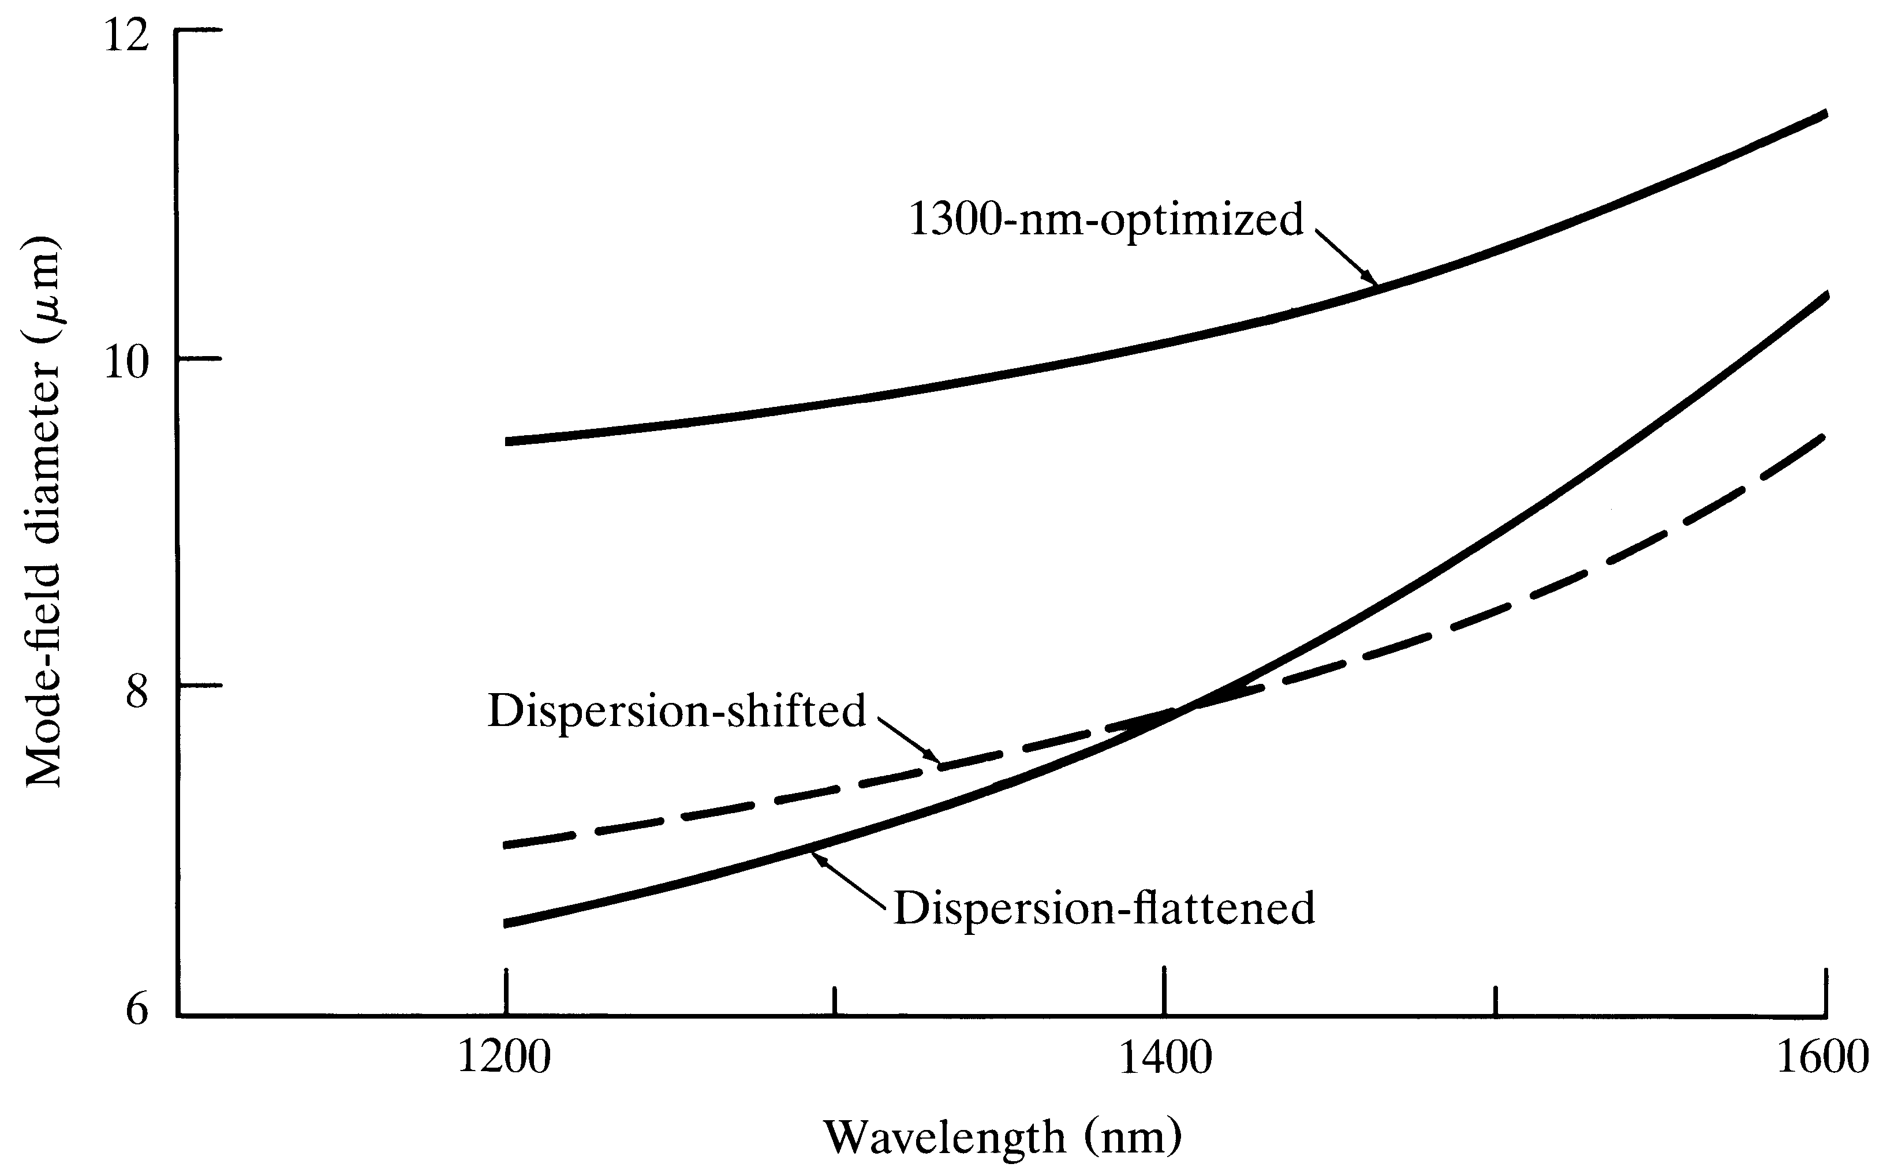
Mode-field diameter Vs wavelength

Slide 29
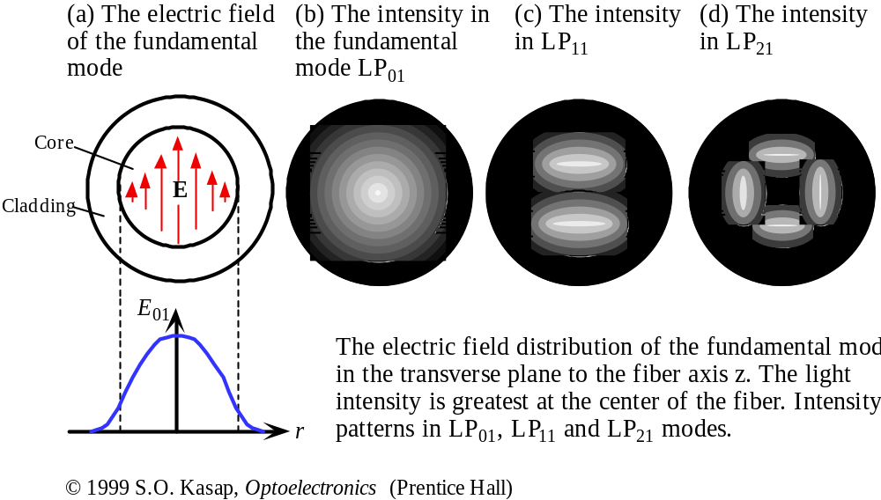

Slide 30
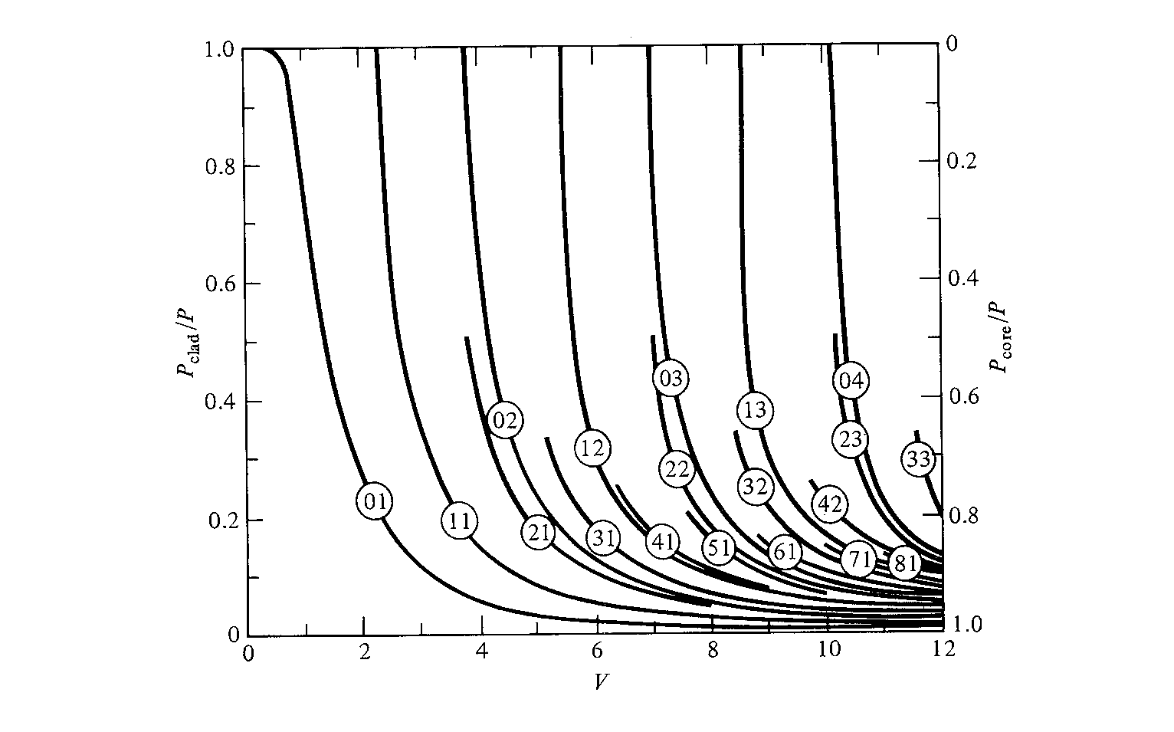
Cladding Power Vs
Normalized Frequency

Slide 31
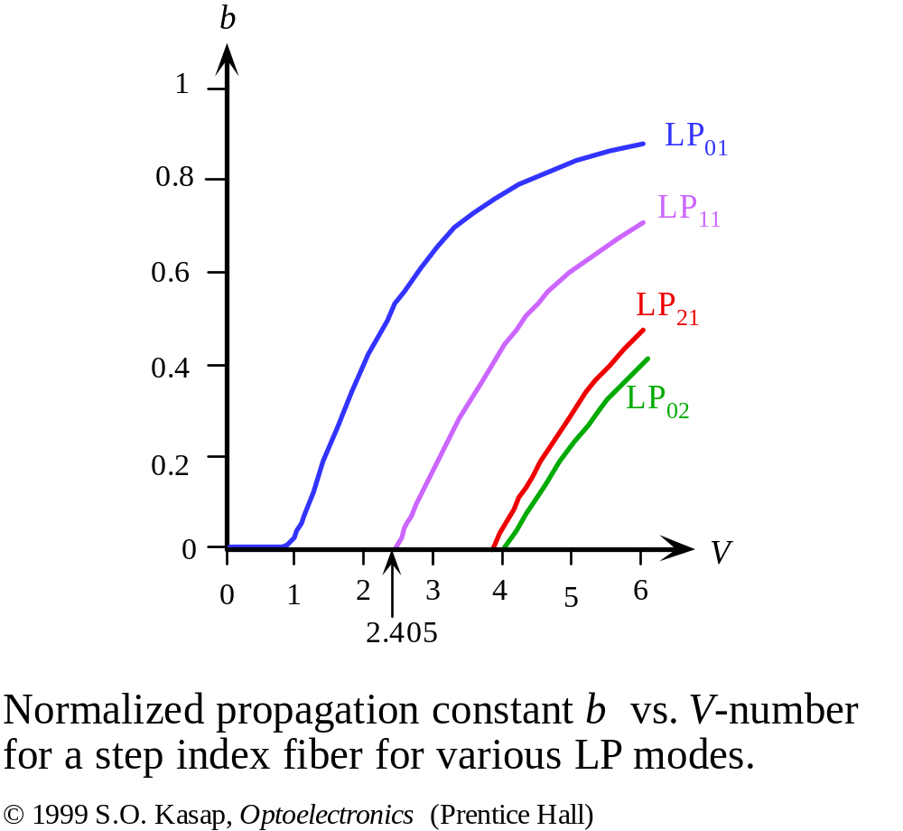

Slide 32
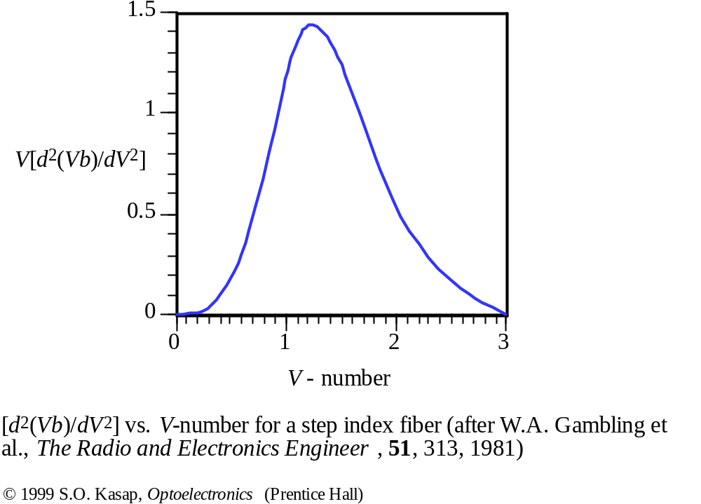

Slide 33
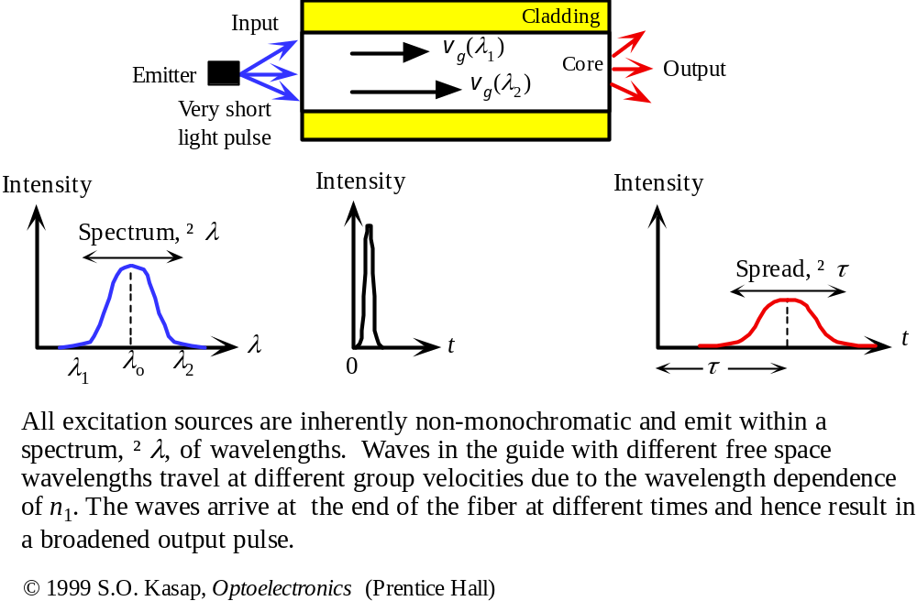
Material Dispersion

Slide 34
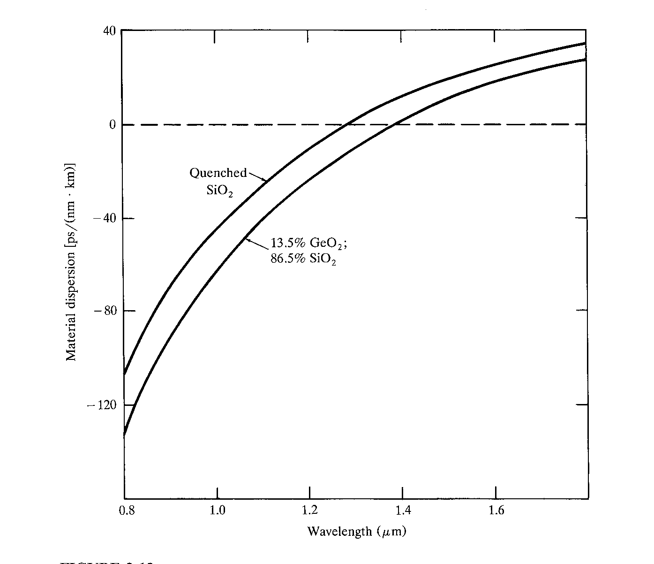
Material Dispersion
Zero
Dispersion
Wavelength

Slide 35
Modifying Chromatic Dispersion
Chromatic Dispersion = Material dispersion
+ Waveguide dispersion
Material dispersion depends on the material properties and difficult to alter
Waveguide dispersion can be altered by changing the fiber refractive index profile
  1300 nm optimized
  Dispersion Shifting (to 1550 nm)
  Dispersion Flattening (from 1300 to 1550 nm)

Slide 36
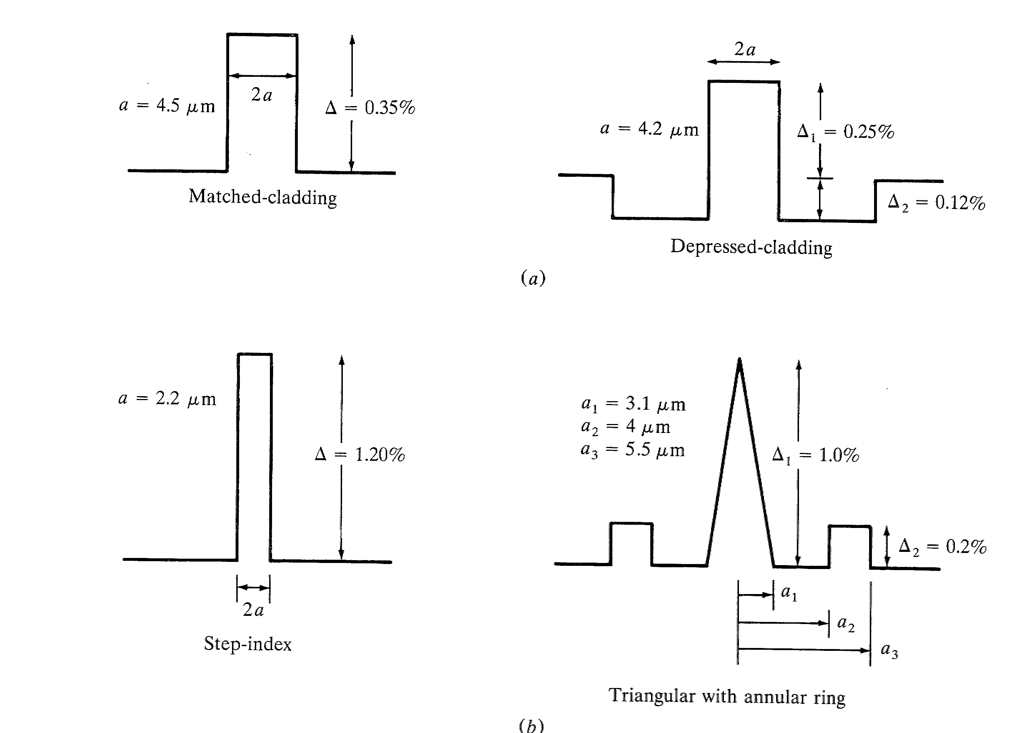
Different Index Profiles
1300 nm optimized
Dispersion Shifted

Slide 37
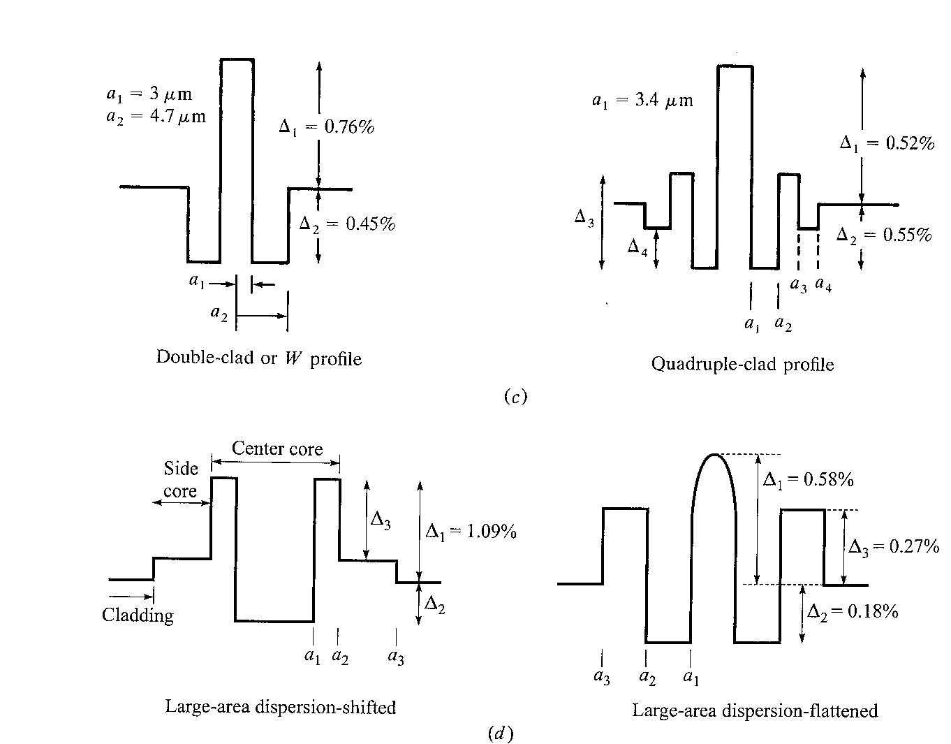
Different Index Profiles
Dispersion
Flattened
Large area dispersion shifted
Large area dispersion flattened

Slide 38
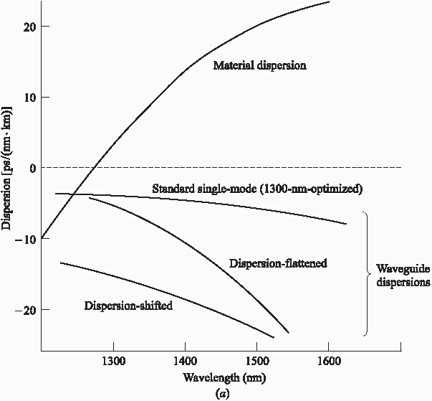
Different dispersion profiles

Slide 39
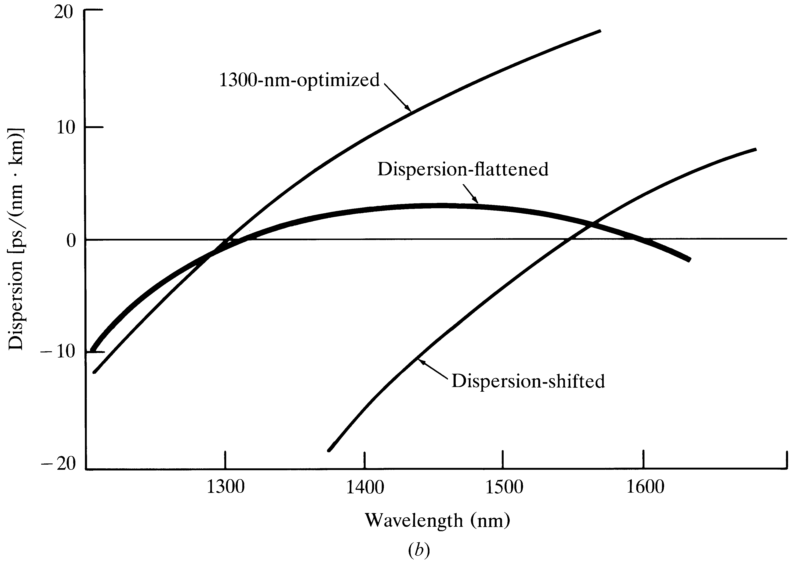
Dispersion Shifting/Flattening

Slide 40
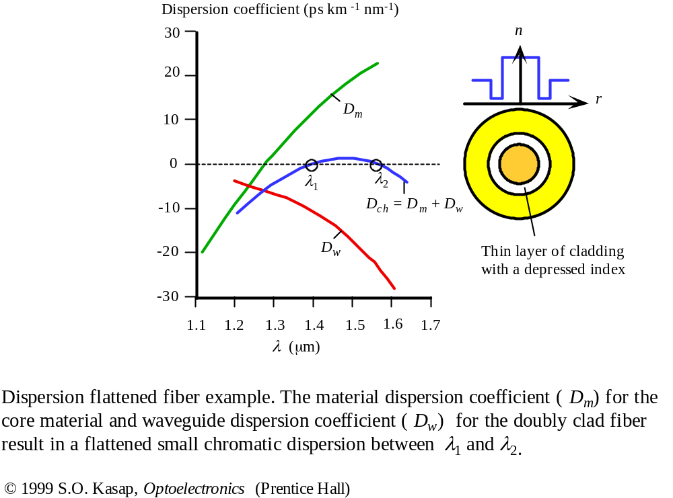

Slide 41
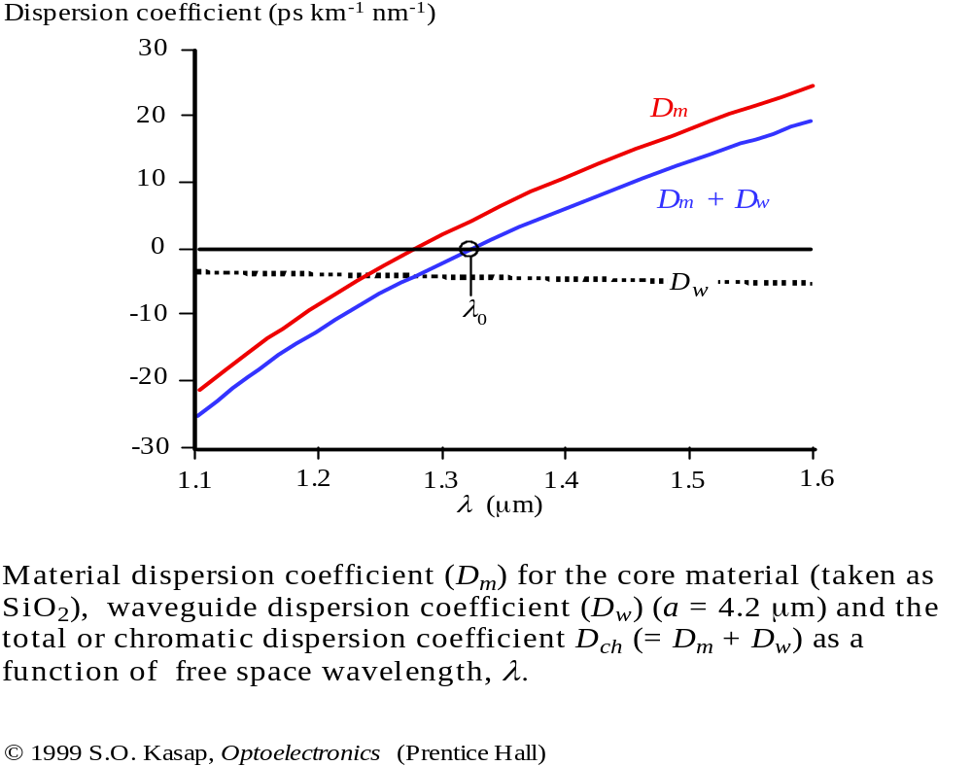
Zero Dispersion Wavelength

Slide 42
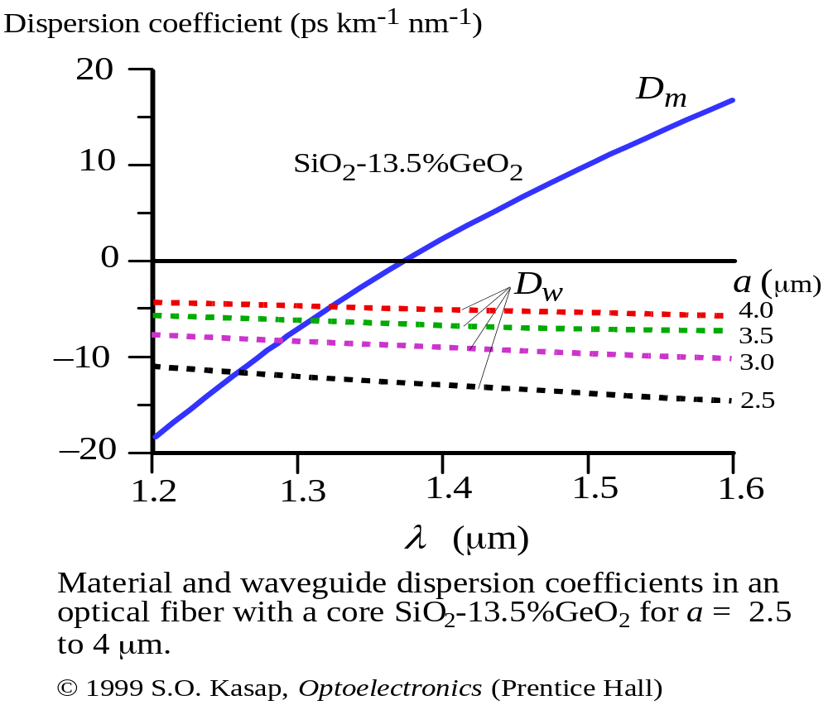

Slide 43




Total Dispersion
For Single Mode Fibers:
For Multi Mode Fibers:
Group Velocity Dispersion
If PMD is negligible

Slide 44
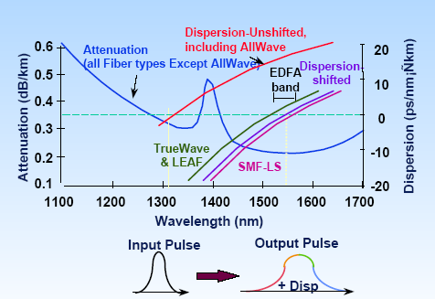
Dispersion & Attenuation Summary

Slide 45
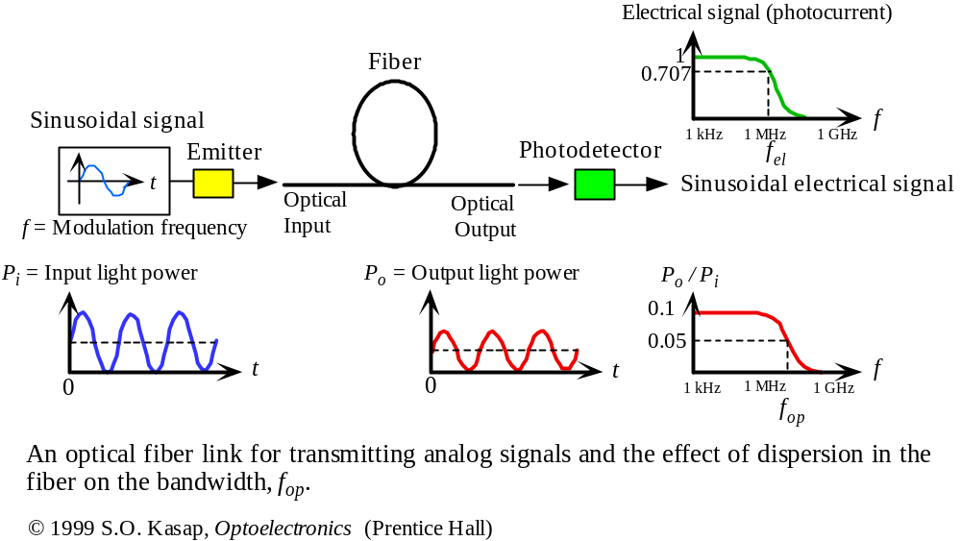
Fiber Optic Link is a Low Pass Filter for Analog Signals

Slide 46
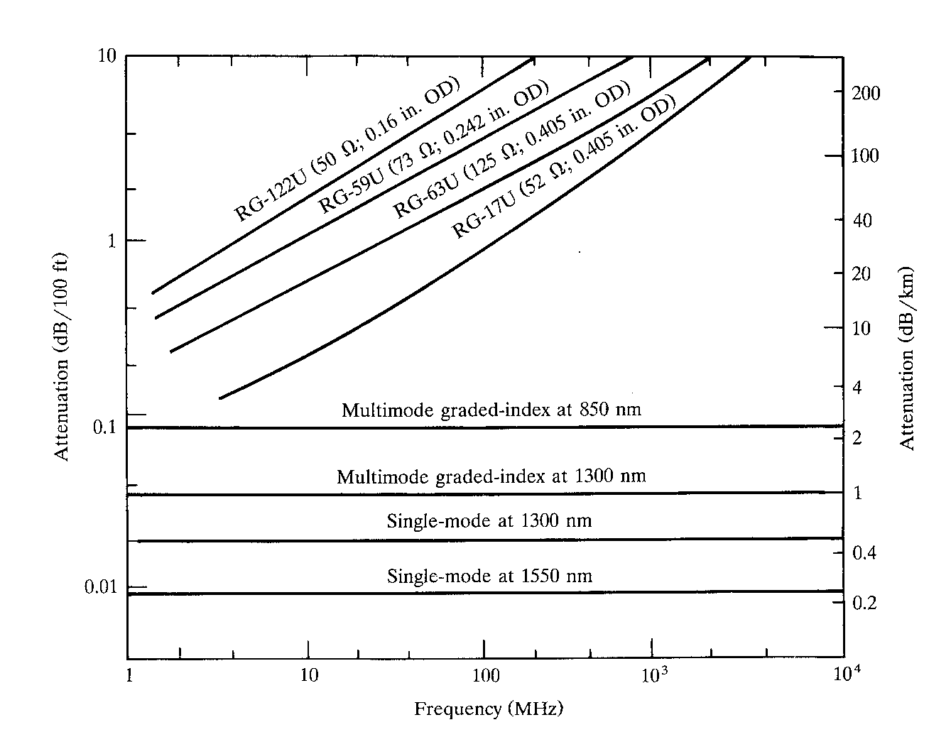
Attenuation Vs Frequency

Slide 47
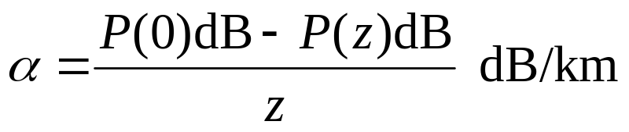
Attenuation in Fiber
Attenuation Coefficient
Silica has lowest attenuation at 1550 nm
Water molecules resonate and give high attenuation around 1400 nm in standard fibers
Attenuation happens because:
  Absorption (extrinsic and intrinsic)
  Scattering losses (Rayleigh, Raman and Brillouin…)
  Bending losses (macro and micro bending)

Slide 48
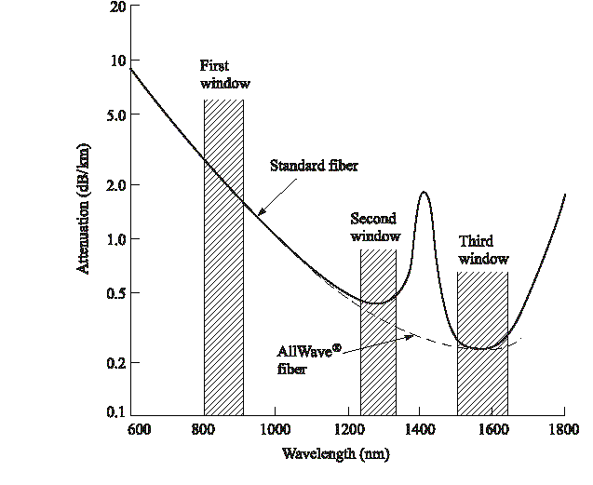
All Wave Fiber for DWDM
Lowest attenuation occurs at
1550 nm for Silica
Notes:
1

Slide 49
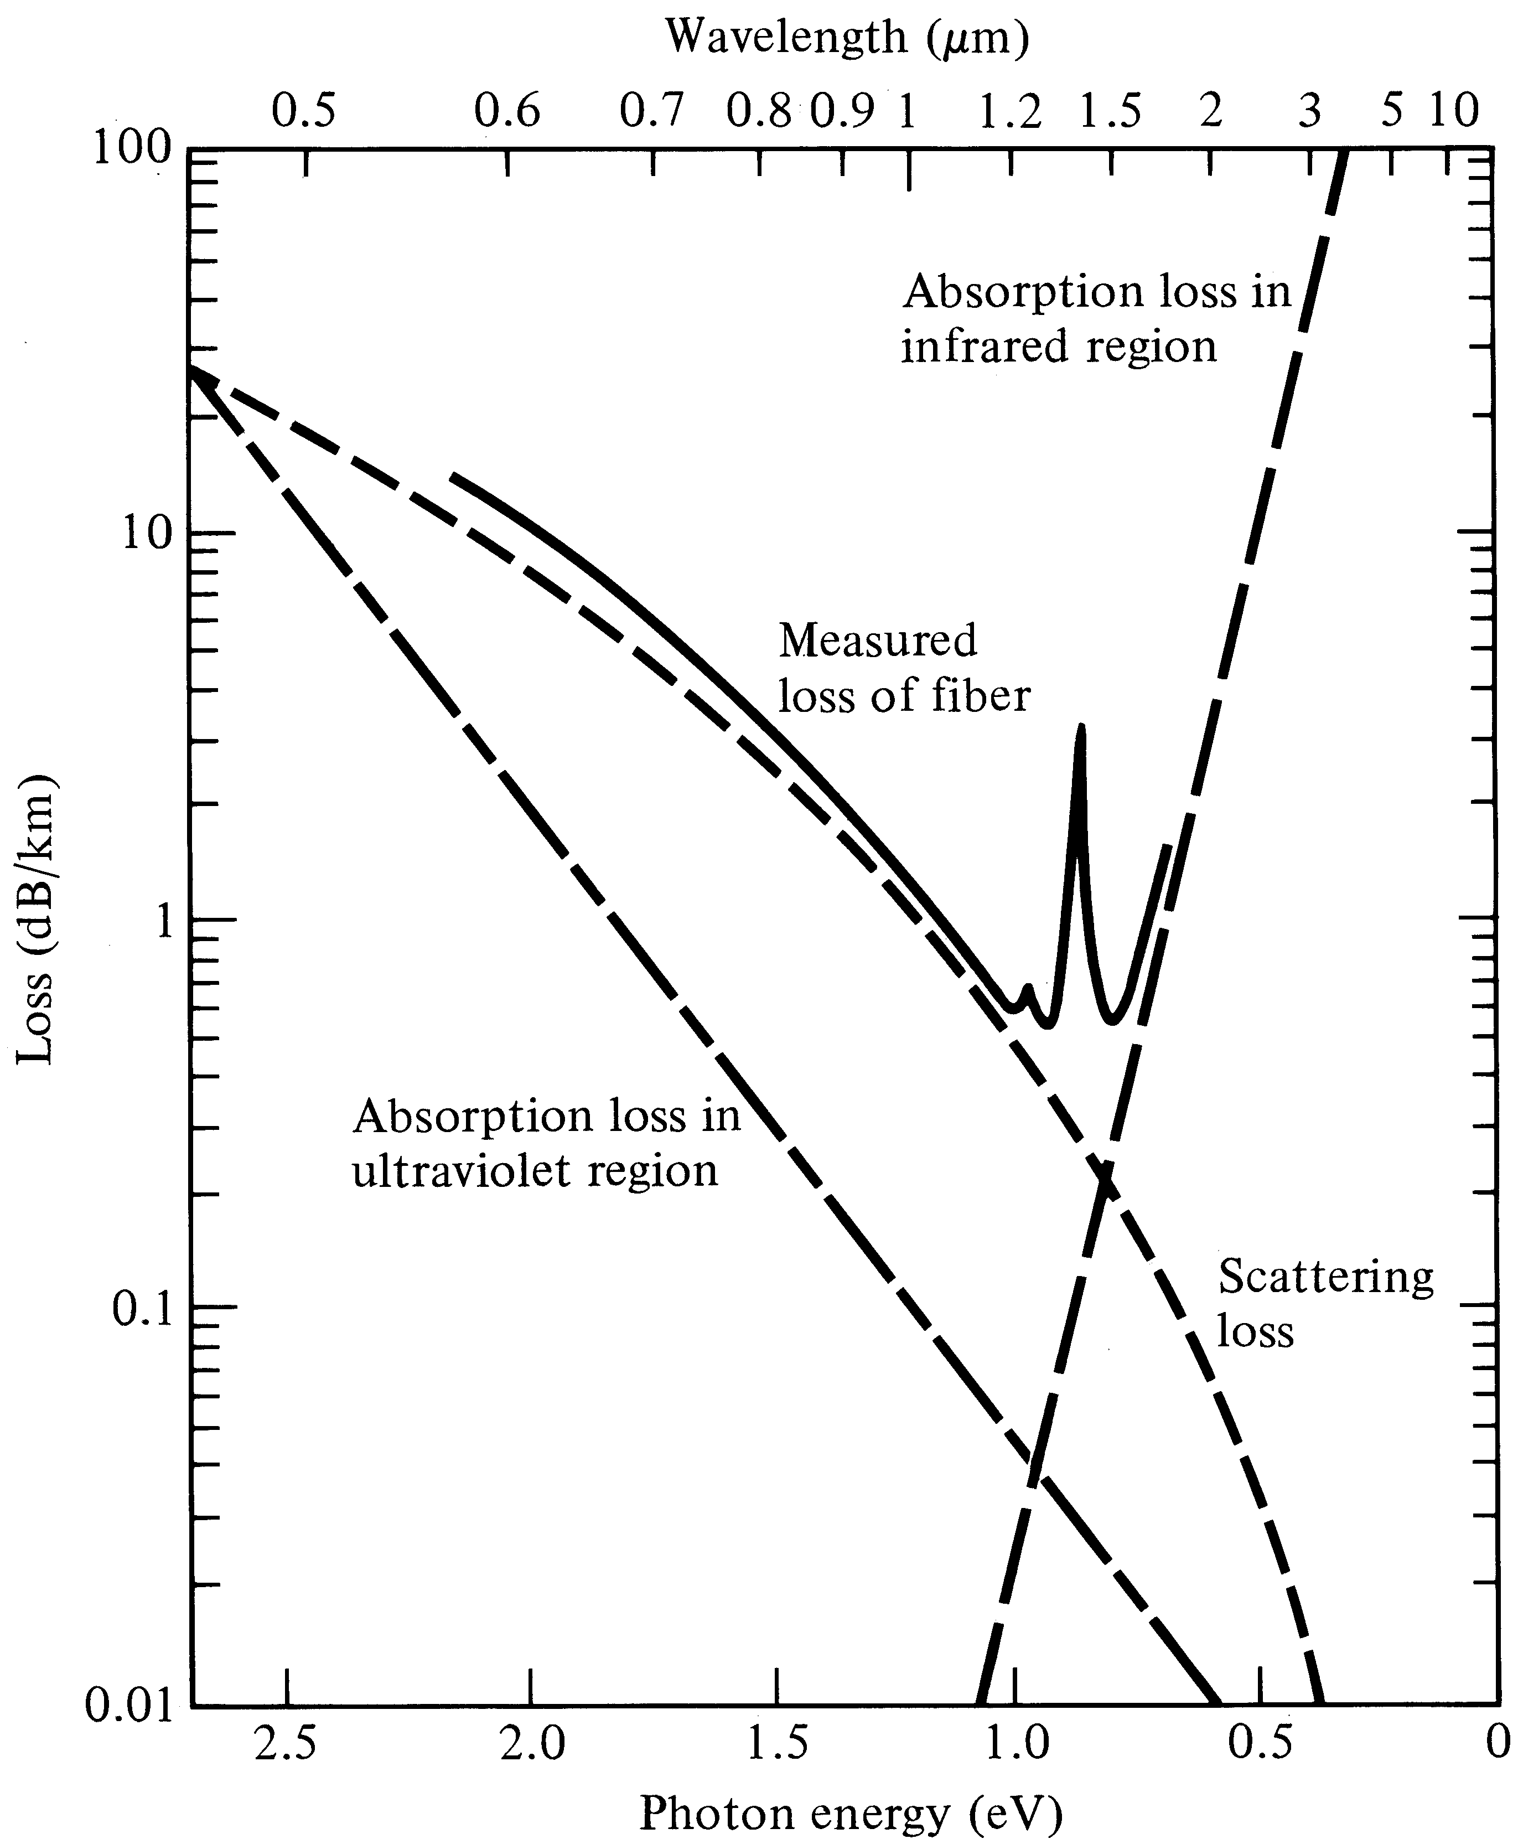
Attenuation characteristics
Notes:
3

Slide 50
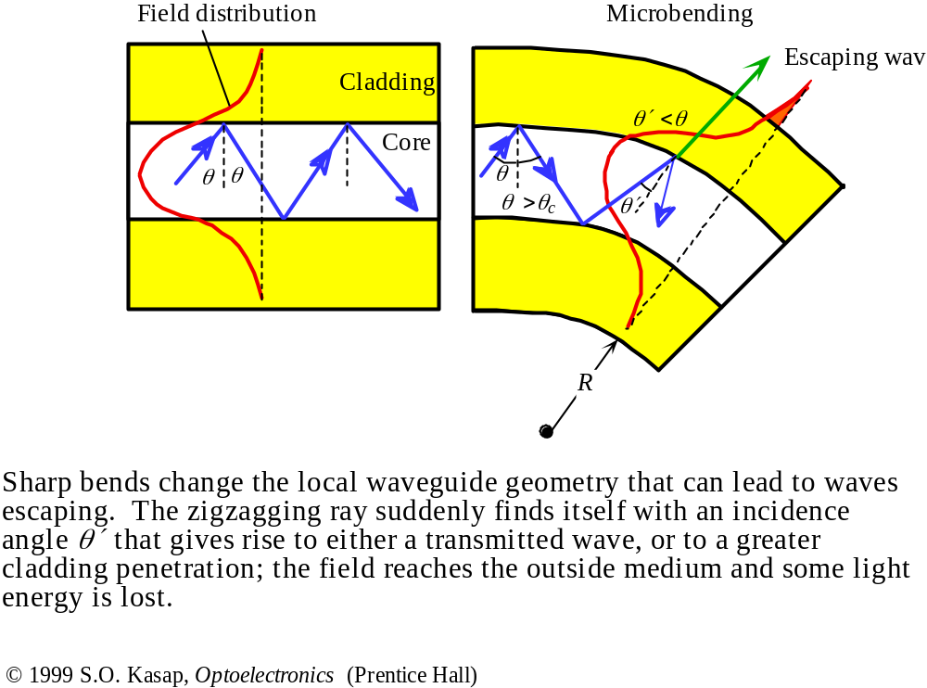
Bending Loss

Slide 51
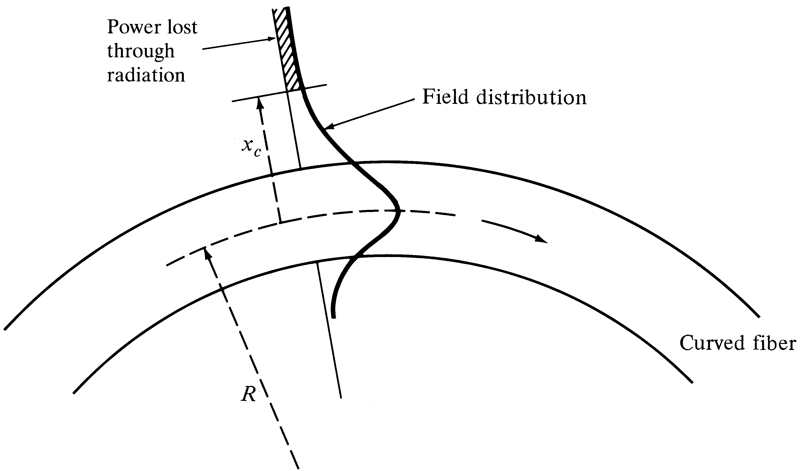
Power loss in a curved fiber
Power in the evanescent field evaporates first
Notes:
5

Slide 52

Bending-induced attenuation

Slide 53

Bending effects on loss Vs MFD

Slide 54

Micro-bending losses
Notes:
6

Slide 55

Fiber
Production

